Slide 1
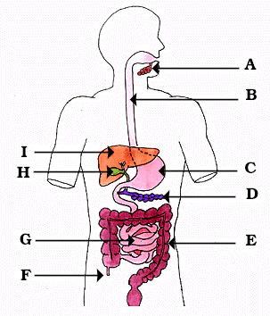
ASSISTING WITH
BOWEL ELIMINATION
MOUTH
ESOPHAGUS
LIVER
STOMACH
GALL BLADDER
PANCREAS
SMALL INTESTINE
LARGE INTESTINE
APPENDIX

Slide 2
NORMAL BOWEL MOVEMENTS
THE FREQUENCY OF BOWEL MOVEMENTS VARIES FROM PERSON TO PERSON.
SOME PEOPLE HAVE A BOWEL MOVEMENT EVERY DAY, SOME EVERY 2 – 3 DAYS, SOME 2 – 3 TIMES A DAY.
MANY PEOPLE HAVE A BOWEL MOVEMENT IN THE MORNING, SOME IN THE EVENING.
STOOLS ARE NORMALLY BROWN IN COLOR.
FECES ARE NORMALLY SOFT, FORMED, MOIST AND SHAPED LIKE THE RECTUM.
FECES HAVE A CHARACTERISTIC ODOR.

Slide 3
DEFINITIONS
DEFECATION - THE PROCESS OF EXCRETING FECES FROM THE RECTUM – HAVING A BOWEL MOVEMENT
FECES - THE SEMI-SOLID MASS OF WASTE PRODUCTS IN THE COLON THAT ARE EXPELLED THROUGH THE ANUS
STOOL – EXCRETED FECES

Slide 4
BOWEL ELIMINATION
REPORT ABNORMAL BOWEL MOVEMENTS TO NURSE:
TOO SOFT
(DIARRHEA)
TOO HARD
(CONSTIPATION)
CONTAINS BLOOD
COMPLAINTS OF PAIN
ABNORMAL COLOR
ABNORMAL IN ANY WAY

Slide 5
FACTORS AFFECTING BOWEL ELIMINATION
PRIVACY – USING A BEDPAN MAY PREVENT A PATIENT FROM DEFECATING. ODORS AND SOUNDS MAY BE EMBARRASSING.
PERSONAL HABITS – MANY PEOPLE HAVE HABITS THAT STIMULATE BOWEL ELIMINATION (DRINKING A CUP OF COFFEE).
AGE – THE GI SYSTEM SLOWS DOWN WITH AGE.
DIET – NEED FIBER. CERTAIN FOODS MAY CAUSE CONSTIPATION OR DIARRHEA IN CERTAIN PEOPLE.
FLUIDS – STOOL CONSISTENCY DEPENDS ON HOW MUCH WATER IS ABSORBED BY THE INTESTINE.
ACTIVITY – EXERCISE STIMULATES PERISTALSIS.
MEDICATIONS – CAN CAUSE CONSTIPATION OR DIARRHEA
DISABILITY - SOME PEOPLE CAN NOT CONTROL BOWEL MOVEMENTS AND DEFECATE WHENEVER FECES ENTER THE RECTUM.

Slide 6
COMMON PROBLEMS
CONSTIPATION – THE PASSAGE OF A HARD, DRY STOOL.
COMMON CAUSES:
LOW FIBER DIET
IGNORING THE URGE TO DEFECATE
DECREASED FLUID INTAKE
INACTIVITY
DRUGS
AGING
CERTAIN DISEASES

Slide 7
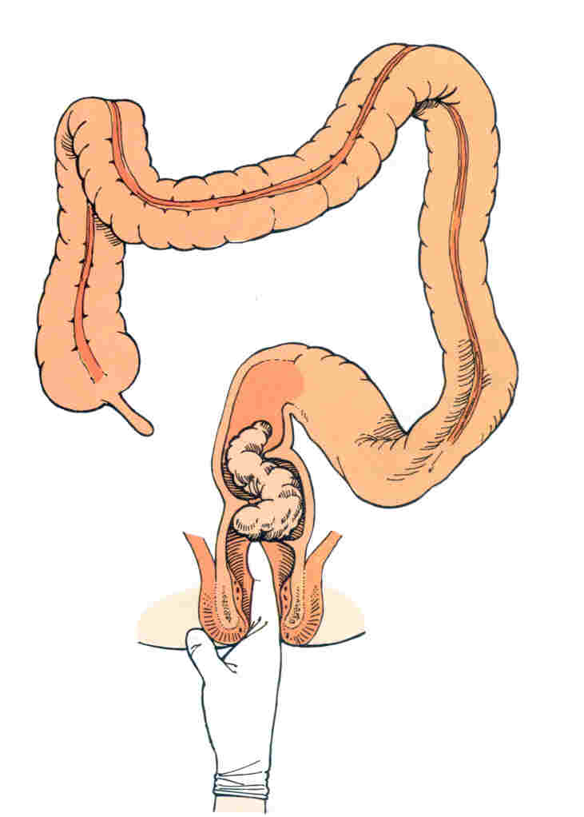
COMMON PROBLEMS
FECAL IMPACTION – THE PROLONGED RETENTION AND BUILDUP OF FECES IN THE RECTUM.
FECES CAN BE HARD OR PUTTY-LIKE
RESULTS IF CONSTIPATION IS NOT RELIEVED.
SYMPTOMS
LIQUID SEEPING FROM ANUS
ABDOMINAL PAIN
NAUSEA, LOSS OF APPETITE
ABDOMINAL DISTENSION
RECTAL PAIN
TREATMENT
DIGITAL REMOVAL
OIL RETENTION ENEMA

Slide 8
COMMON PROBLEMS
DIARRHEA – THE FREQUENT PASSAGE OF LIQUID STOOLS.
CAUSES:
INFECTIONS
CERTAIN DRUGS
IRRITATING FOODS
MICROORGANISMS IN THE FOOD
TREATMENT:
ASSIST WITH ELIMINATION NEEDS PROMPTLY
DISPOSE OF STOOLS PROMPTLY
GOOD SKIN CARE
FLUID REPLACEMENT
MEDICATION

Slide 9
ANAL INCONTINENCE
THE INABILITY TO CONTROL THE PASSAGE OF FECES THROUGH THE ANUS.
CAUSES:
THE MUSCLE THAT SURROUNDS THE ANUS IS WEAK.
UNABLE TO GET TO THE BATHROOM.
THE BRAIN DOES NOT GET THE MESSAGE.
TREATMENT:
GOOD SKIN CARE IS ESSENTIAL.
A BOWEL TRAINING PROGRAM MAY BE ESTABLISHED.
DO NOT EMBARRASS OR HUMILIATE THE PATIENT.

Slide 10
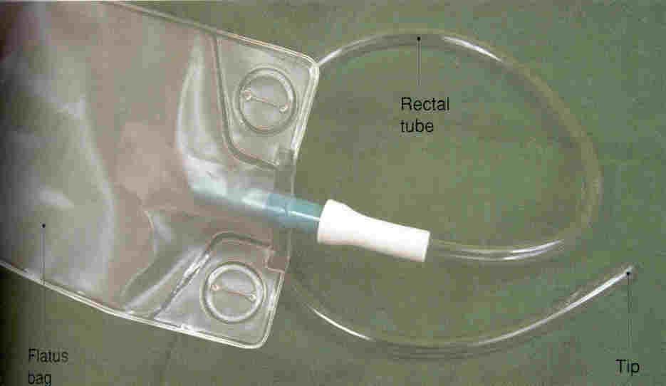
FLATULENCE
GAS OR AIR PASSED THROUGH THE ANUS
IF THE GAS IS NOT EXPELLED, THE INTESTINES MAY BECOME DISTENDED.
THE PATIENT IS FIRST AMBULATED TO SEE IF THAT HELPS HIM TO “PASS” GAS.
IF AMBULATION DOES NOT HELP, A RECTAL TUBE MAY BE INSERTED.

Slide 11
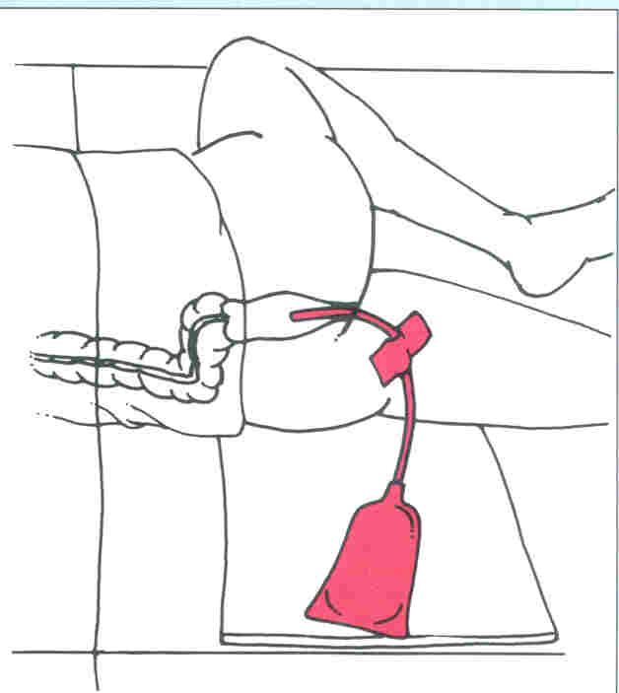
GUIDELINES FOR GIVING A RECTAL TUBE
LUBRICATE THE TIP OF THE TUBE.
POSITION THE PERSON IN THE LEFT SIM’S POSITION.
INSERT THE TUBE GENTLY, 2 – 4 INCHES INTO THE RECTUM.
POSITION THE TUBE SO IT RESTS ON A BED PROTECTOR.
LEAVE THE TUBE IN PLACE FOR 20 MINUTES.

Slide 12
BOWEL TRAINING
GOAL
REGAIN CONTROL OF BOWEL MOVEMENTS
DEVELOP A REGULAR PATTERN OF ELIMINATION
STEPS
USUAL PATTERN IS DETERMINED
REGULAR SCHEDULE IS ESTABLISHED
EVALUATE AND CHANGE AS NECESSARY

Slide 13
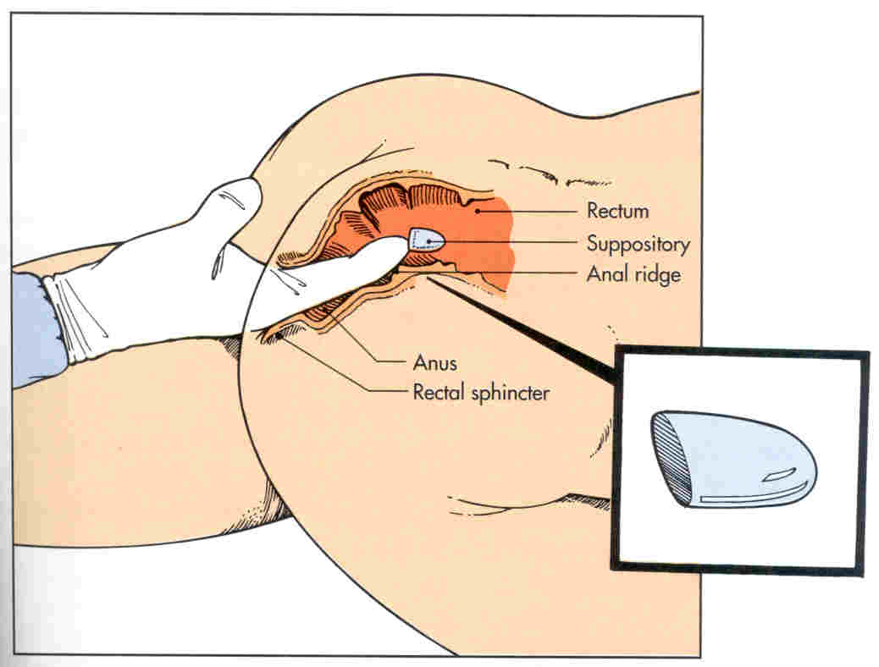
SUPPOSITORY
A SUPPOSITORY IS A CONE-SHAPED, SEMISOLID SUBSTANCE THAT IS INSERTED INTO THE RECTUM
USUALLY GIVEN BY THE NURSE

Slide 14
ENEMAS
THE INTRODUCTION OF FLUID INTO THE RECTUM AND LOWER COLON
ORDERED BY THE DOCTOR
GIVEN TO REMOVE FECES AND TO RELIEVE CONSTIPATION
ALSO GIVEN TO CLEAN THE BOWEL OF FECES BEFORE SURGERY, X-RAYS, OR CHILDBIRTH

Slide 15
TYPES OF ENEMAS
CLEANSING ENEMAS
TAP WATER
SOAPSUDS
ENEMAS TILL CLEAR
COMMERCIAL
FLEETS (PACKAGED)
OIL RETENTION

Slide 16
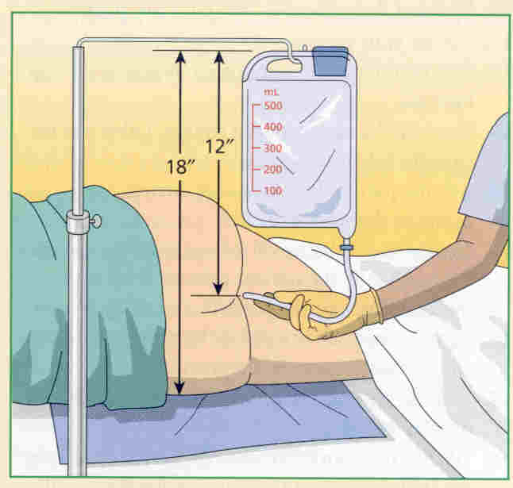
COMFORT AND SAFETY MEASURES
SOLUTION TEMPERATURE SHOULD BE 105º
ADULTS RECEIVE BETWEEN 500 – 1000CC OF SOLUTION
POSITION PATIENT IN THE LEFT SIM’S POSITION
THE ENEMA BAG IS RAISED 12 INCHES ABOVE THE ANUS OR 18 INCHES ABOVE THE BED
LUBRICATE THE TUBING AND INSERT IT 3 – 4 INCHES INTO THE RECTUM
GIVE THE SOLUTION SLOWLY ( OVER 10 – 15 MIN.)
HAVE THE PERSON VOID BEFORE BEGINNING

Slide 17
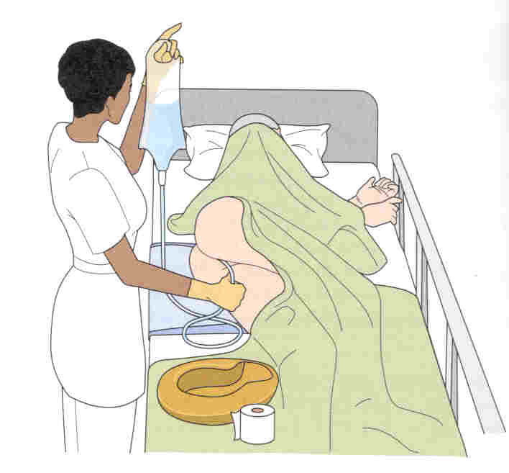
COMFORT AND SAFETY MEASURES
THE ENEMA TUBE IS HELD IN PLACE WHILE THE SOLUTION IS BEING GIVEN
THE SOLUTION SHOULD BE RETAINED IN THE BOWEL FOR A CERTAIN LENGTH OF TIME
THE BATHROOM MUST BE VACANT
OBSERVE THE ENEMA RESULTS AND REPORT THEM TO THE NURSE

Slide 18
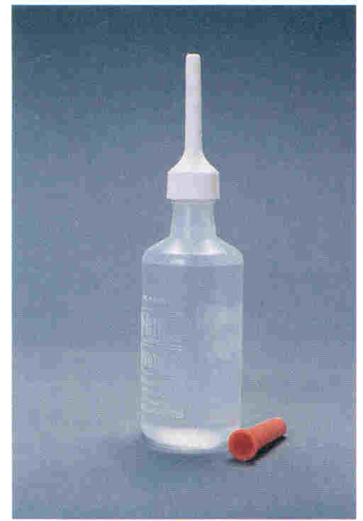
FLEETS PACKAGE ENEMA
COMES READY TO GIVE
WARM IT UNDER RUNNING WATER
INSERT 2 INCHES INTO THE RECTUM
ROLL UP FROM THE BOTTOM – DO NOT RELEASE PRESSURE

Slide 19
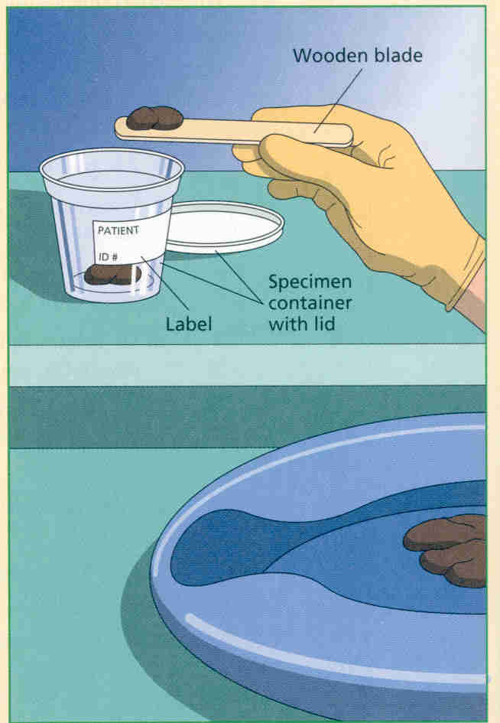
STOOL SPECIMEN
USE A TONGUE DEPRESSOR TO TRANSFER THE STOOL SPECIMEN FROM THE COLLECTION CONTAINER TO THE SPECIMEN CONTAINER.
A STOOL SPECIMEN MUST NOT BE CONTAMINATED WITH URINE.
TAKE THE SPECIMEN TO THE LABORATORY OR TO THE NURSE.

Slide 20
THE PERSON WITH AN OSTOMY
AN OSTOMY IS THE SURGICAL CREATION OF AN ARTIFICIAL OPENING
THE OPENING IS CALLED A STOMA
A COLOSTOMY IS THE SURGICAL CREATION OF AN ARTIFICIAL OPENING BETWEEN THE COLON AND THE ABDOMINAL WALL
AN ILEOSTOMY IS A SURGICALLY CREATED OPENING BETWEEN THE SMALL INSTESTINE AND THE ABDOMINAL WALL

Slide 21
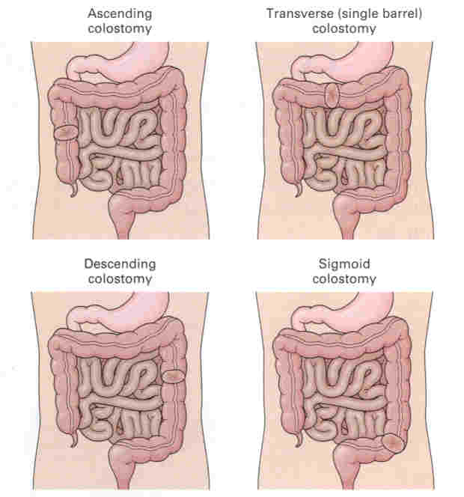
COLOSTOMY SITES

Slide 22
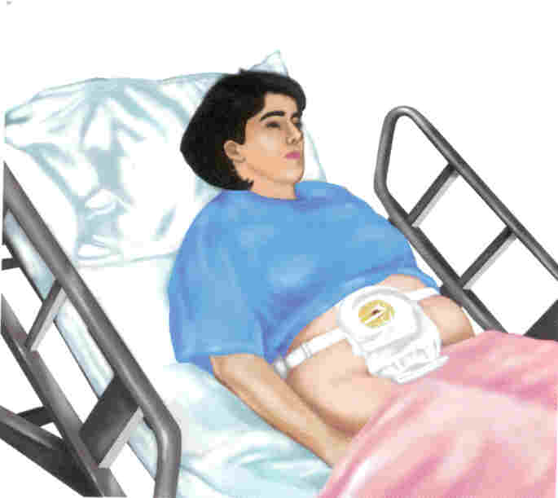
GUIDELINES FOR PERFORMING OSTOMY CARE
KEEP THE PERSON’S SKIN CLEAN AND DRY AND OBSERVE FOR REDNESS, RASH, OR SKIN BREAKDOWN.
THE POUCH IS EMPTIED PRN (AS NEEDED) AND IS CHANGED EVERY 3 – 7 DAYS, OR AS NEEDED.

Slide 23
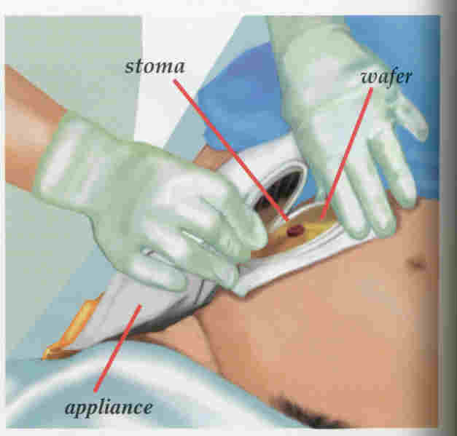
GENTLY REMOVE THE COLOSTOMY APPLIANCE (COLOSTOMY BAG) AND PLACE IT IN THE BEDPAN.

Slide 24
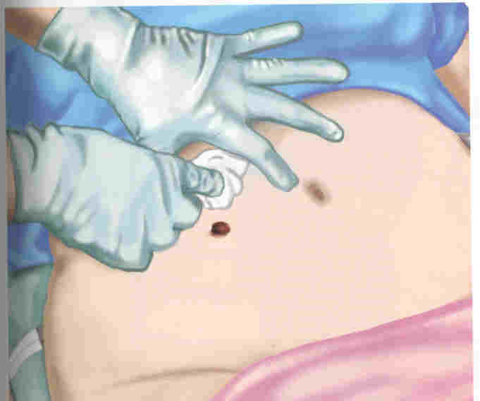
CLEAN AROUND THE STOMA WITH SOAP (MILD) AND WATER

Slide 25
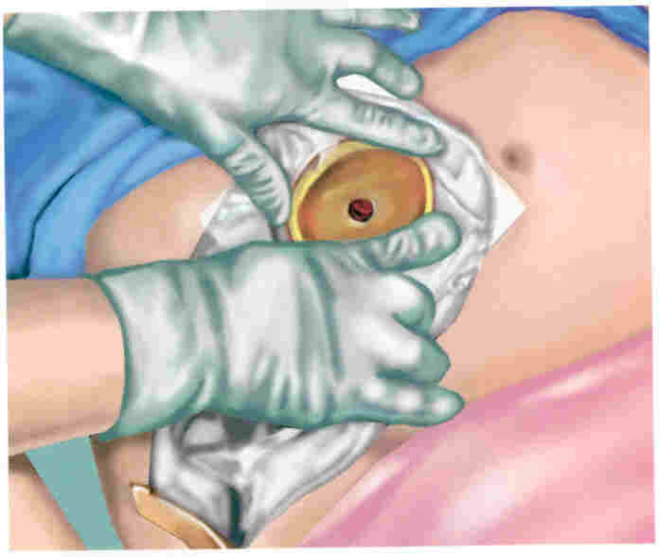
REMOVE THE ADHESIVE BACKING AND CENTER THE POUCH OVER THE STOMA. APPLY GENTLE PRESSURE.
FASTEN THE CLAMP AT THE BOTTOM OF THE BAG.
DEODORANT IS PLACED IN THE BAG TO PREVENT ODORS.
DO NOT LET THE PERSON SHOWER OR BATHE FOR 1-2 HOURS AFTER APPLYING THE POUCH.

Slide 26
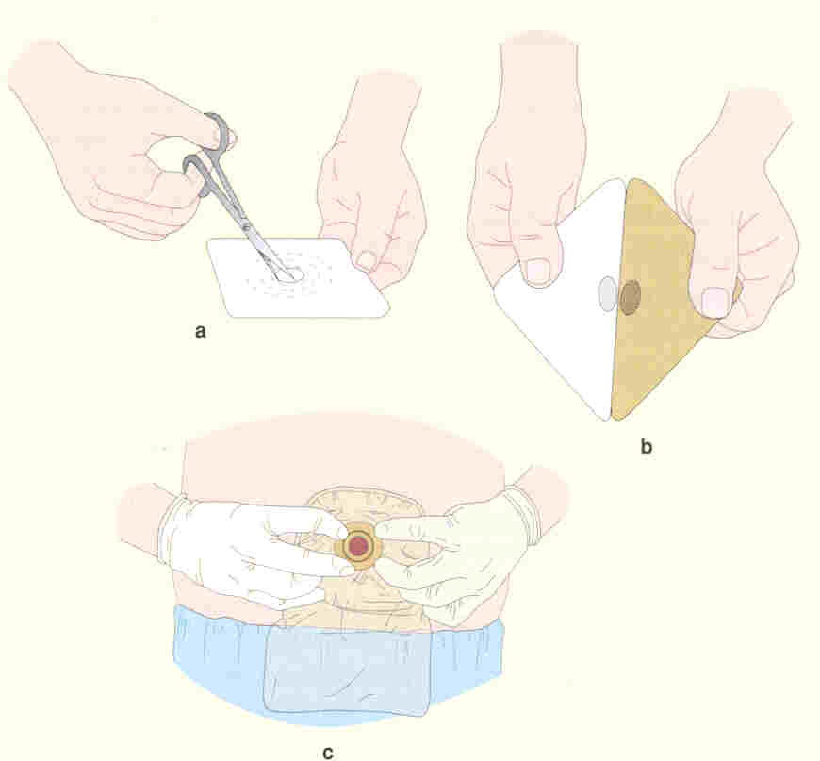
THE WAFER MAY HAVE TO BE CUT TO THE PROPER STOMA SIZE

