Slide 1
Welcome to
Wilco Area Career Center’s
Awards Night 2014

Slide 2
Auto Body
Bailey Hambly – Plainfield Central

Slide 3
Will County Auto Rebuilders Scholarship
Austin Martinez

Slide 4
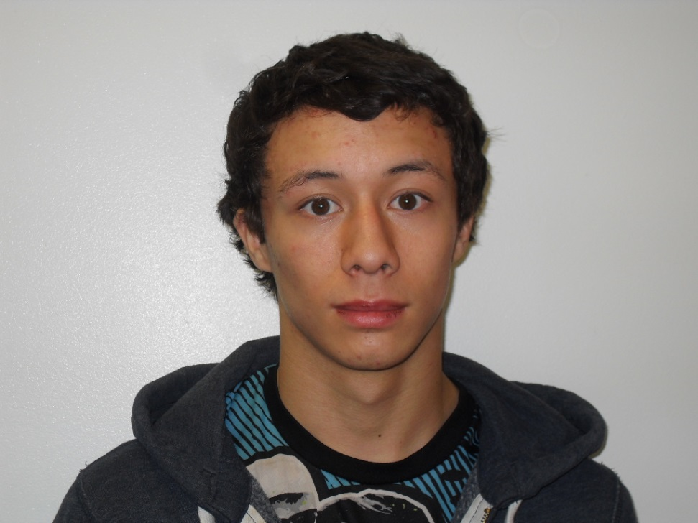
Auto Body Student of the Year
Austin Martinez
Lockport

Slide 5
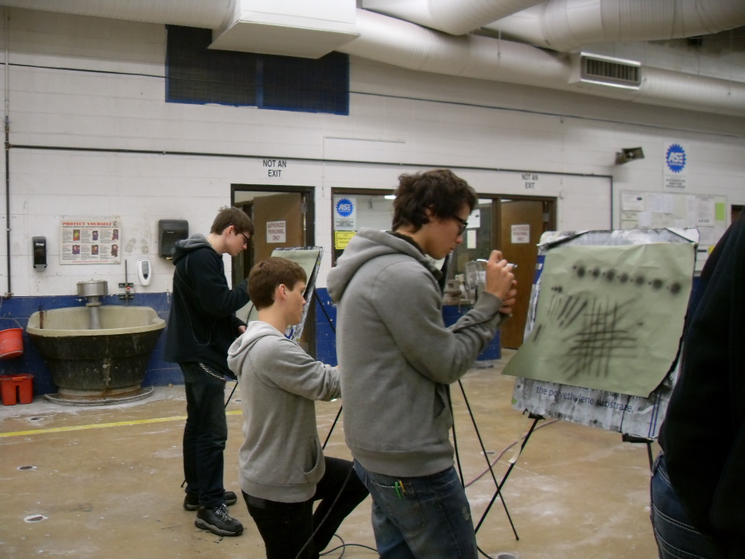
Character Traits
Trustworthy
Always on Task
Easy to Instruct
Eager to Learn
Works Beyond the Classroom
Focused on Career

Slide 6
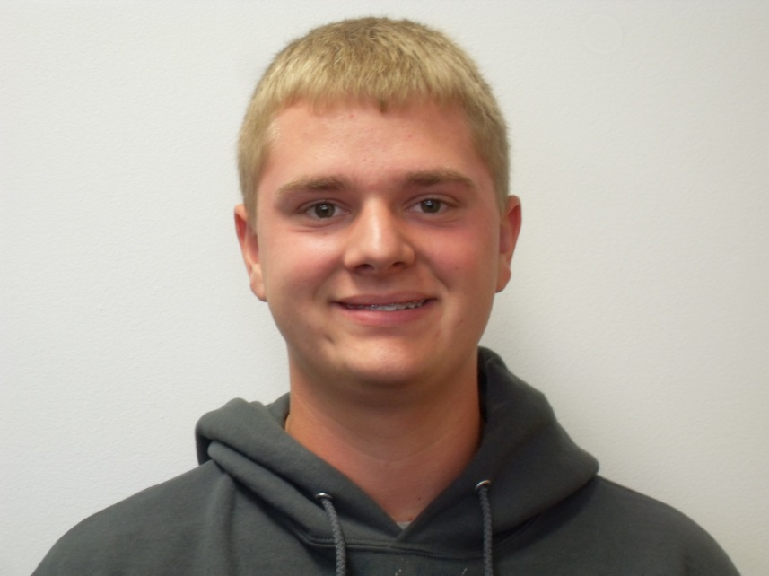
2014 Wilco Scholarship Recipient James Divis Auto Service Program
Lemont High School

Slide 7
Auto Service Student of the year
James Divis
Lemont

Slide 8
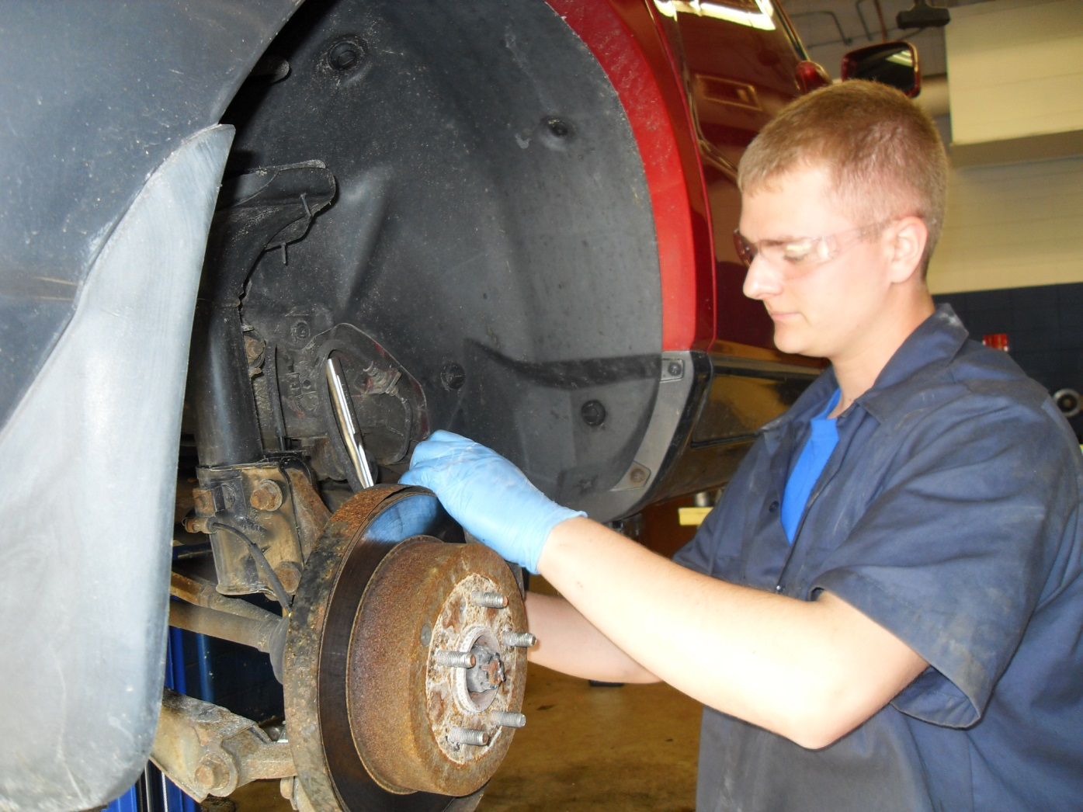
Character Traits
Hard Working
Enthusiastic
Interested in Field
Good Attendance
Polite
Comes to Work Every Day

Slide 9
Certified Nursing Assistant
Muroo Hamed – Plainfield East
Kelly Smith – Plainfield East
Emily Thomas – Plainfield North
Steven Ustupski – Lemont
Lauren Werth – Lockport

Slide 10
CNA - State Conference Finalists
Kendall Cunningham – Plainfield South
Audrey Folk – Plainfield South
Gianna Fox – Plainfield East
Muroo Hamed – Plainfield East
Michelle Kula – Lockport
Rebekah Lelak – Lockport
Sarah Paetsch– Romeoville
Kelly Smith – Plainfield East
Kaci Svornik - Lockport
Emily Thomas – Plainfield North
Sarah Toth – Plainfield South
Steve Ustupski– Lemont
Lauren Werth - Lockport
Alex Wyatt - Lemont

Slide 11
CNA - State Conference Medalists
1st Place : Clinical Specialty – Muroo Hamed, Plainfield East
2nd Place : Home Health Aide – Erica Moyes, Lockport

Slide 12
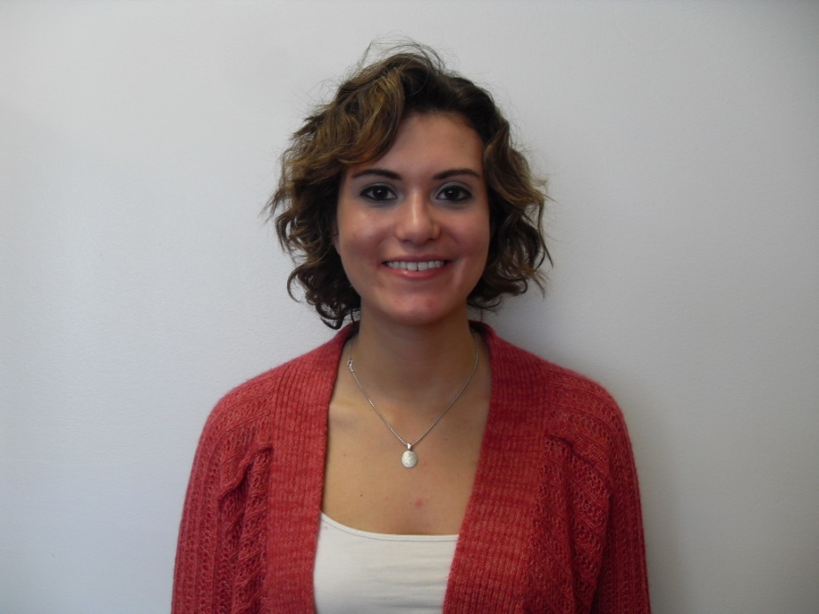
2014 Wilco Scholarship Recipient Certified Nursing Assistant Program Ms. Aldworth’s Class:
Lauren Werth
Lockport High School

Slide 13
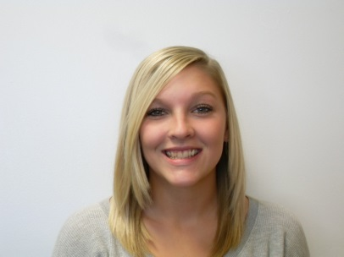
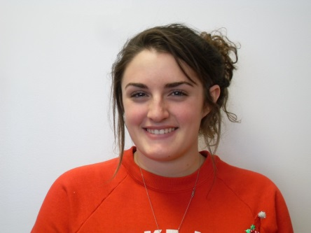
HOSA SCHOLARSHIP Ms. Aldworth’s Class:
Kelly Smith – Plainfield East
Kaci Svornik - Lockport

Slide 14
Certified Nursing Assistant Student of the Year – Ms. Aldworth Kelly Smith
Plainfield East

Slide 15
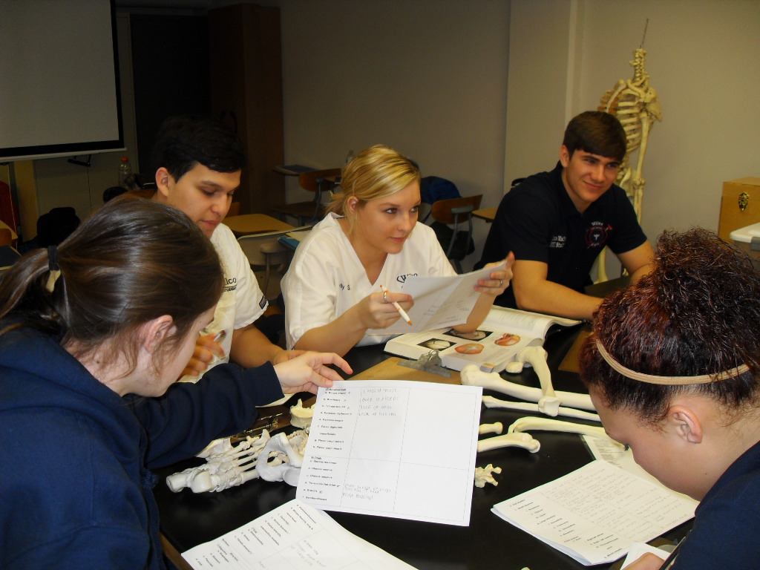
Character Traits
Compassionate
Positive
Dedicated
Focused
Intelligent
Cute as a Button!

Slide 16
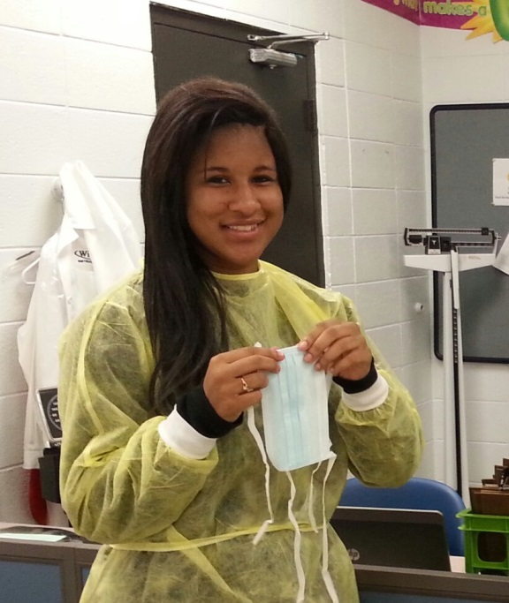
2014 Wilco Scholarship Recipient Certified Nursing Assistant Mrs. Budde’s Class:
Jordan Ruff
Plainfield Central

Slide 17
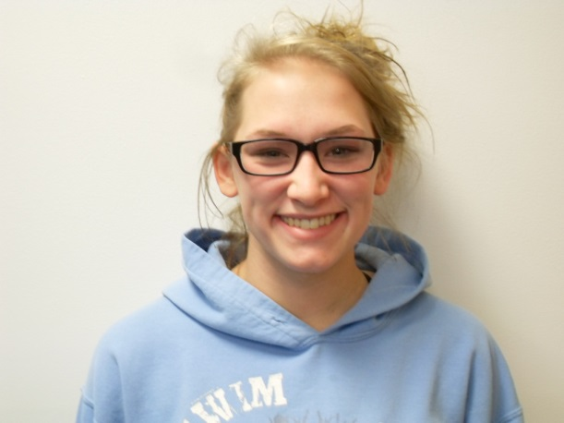
2014 Wilco Scholarship Recipient Certified Nursing Assistant Mrs. Budde’s Class:
Emily Thomas
Plainfield North

Slide 18
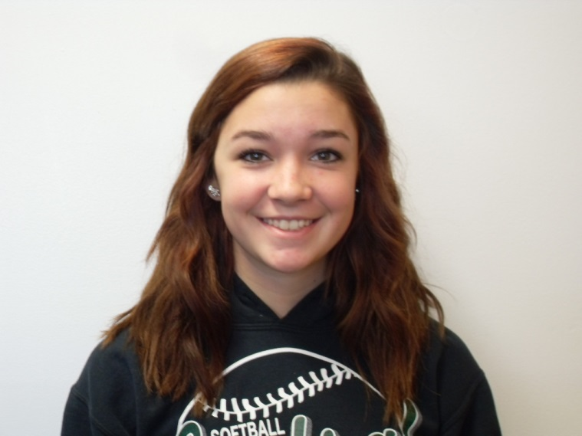
HOSA SCHOLARSHIP Mrs. Budde’s Class:
Erica Moyes – Plainfield Central

Slide 19
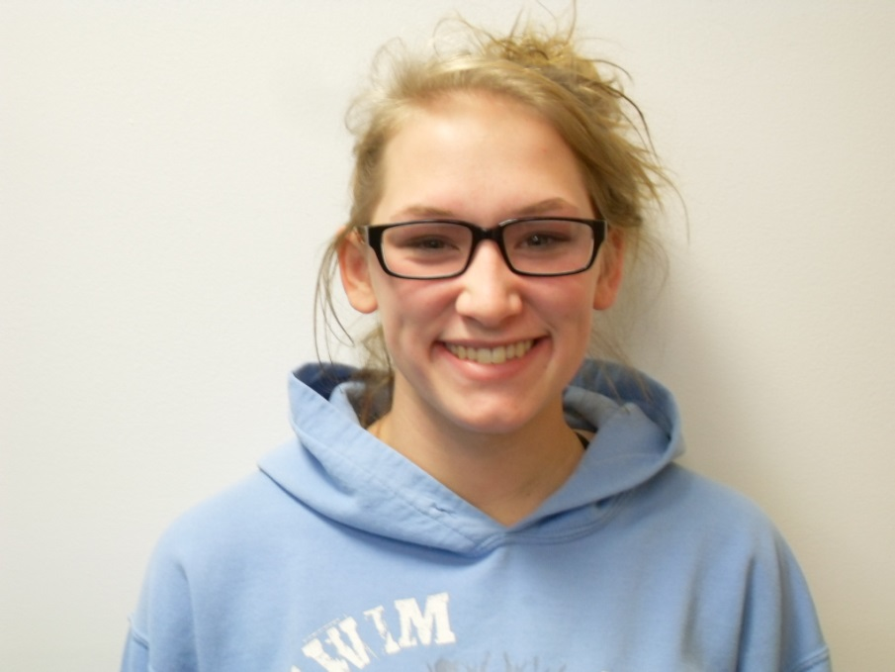
Certified Nursing Assistant Student of the Year – Mrs. Budde Emily Thomas
Plainfield North

Slide 20
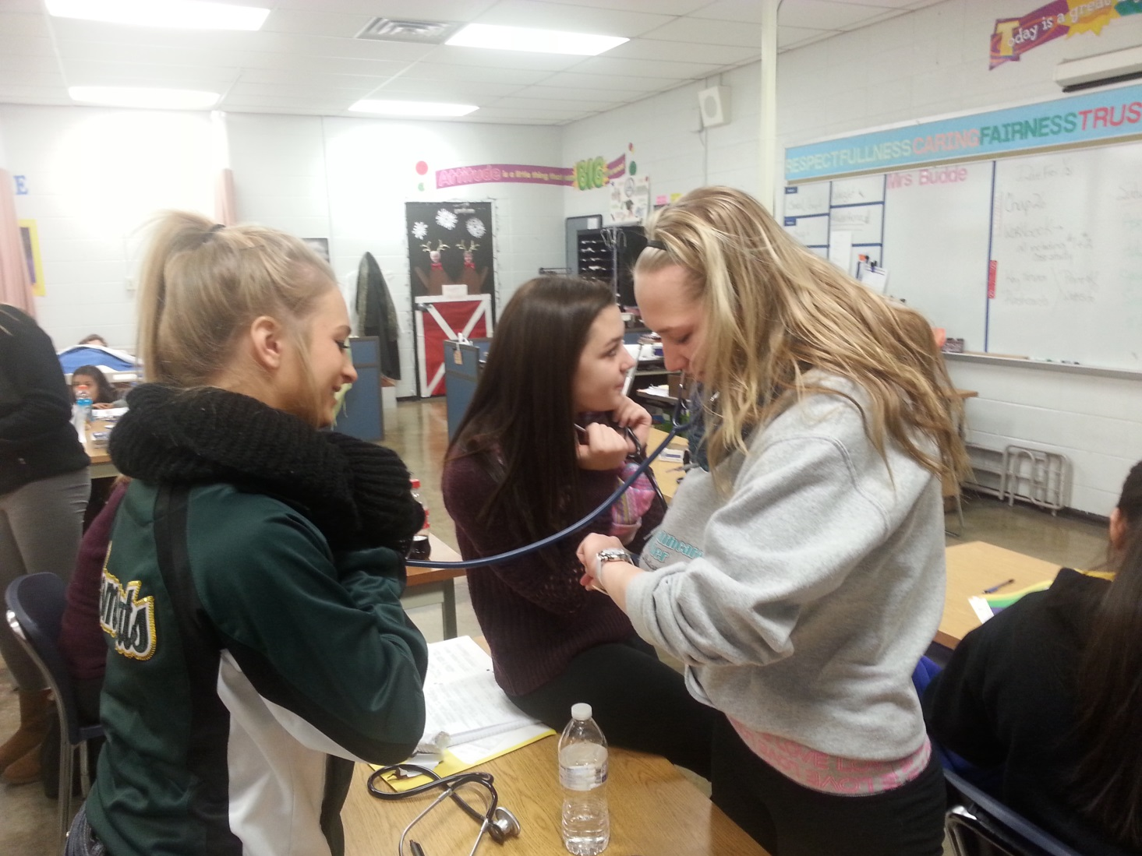
Character Traits
Organized
Dedicated
Focused
Kind & Compassionate
Skilled
HOSA Leader

Slide 21
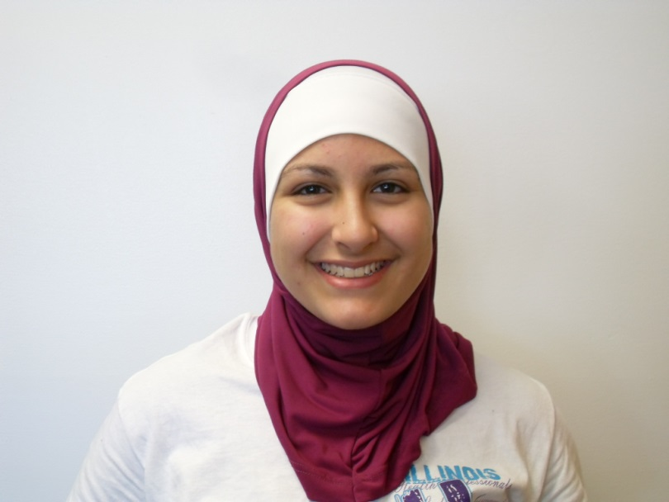
2014 Wilco Scholarship Recipient Certified Nursing Assistant Mrs. Sillitti’s Class:
Muroo Hamed
Plainfield East

Slide 22
Computer Technology Student of the Year
Angela Hoban
Plainfield Central

Slide 23
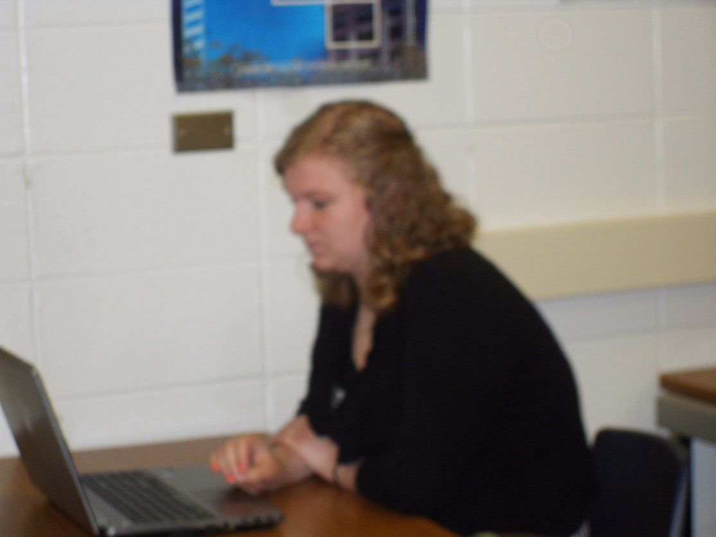
Character Traits
Diligent
Honest
Respectful
Hard Worker
Good Attitude

Slide 24
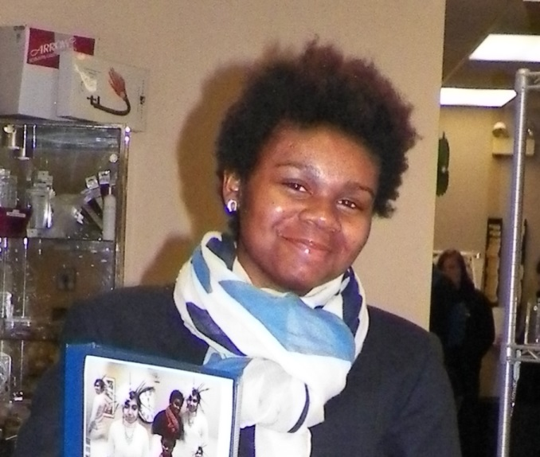
Cosmetology Student of the Year
Andreasea Cramer
Bolingbrook

Slide 25
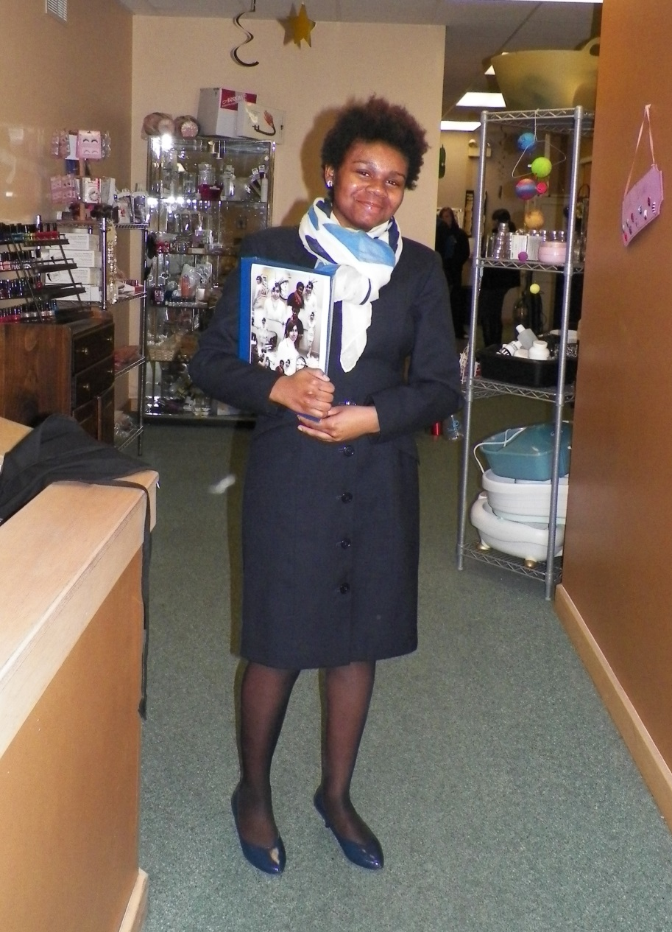
Character Traits
Strong Work Ethic
Respectful of Others
Team Player
Willing to Help
Great Attendance
Most Improved

Slide 26
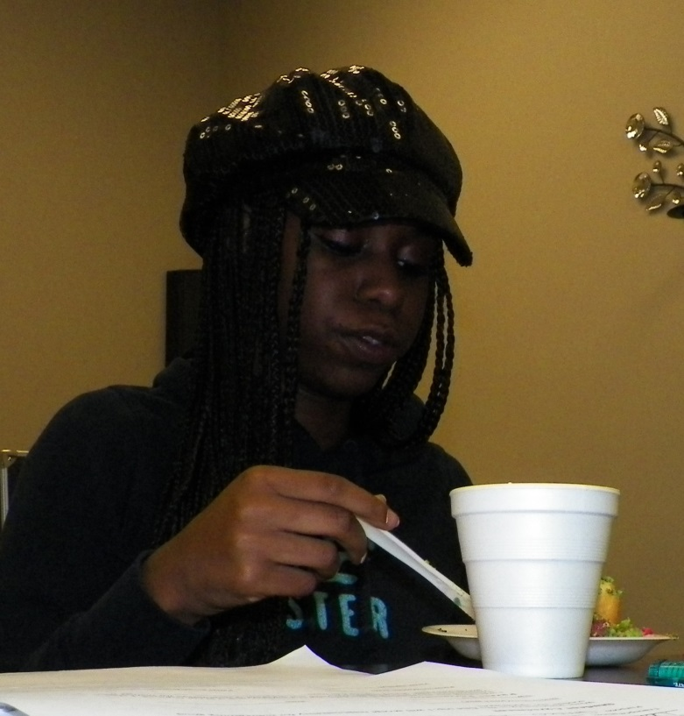
Nail Tech Student of the Year
Octavia Roberts
Bolingbrook

Slide 27
Character Traits
Strength & Drive
Determined
N ever Quits
Good Manners
Great Sense of Humor
*Camera Shy*

Slide 28
Criminal Justice
Emily Ward – Plainfield Central

Slide 29
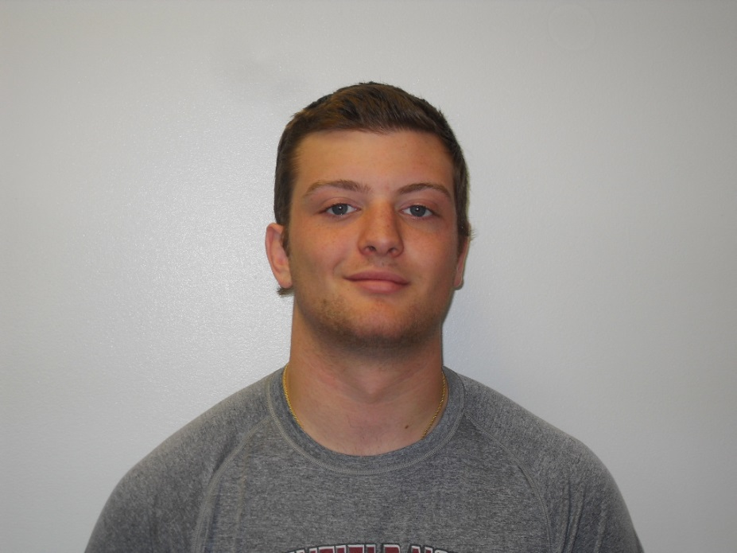
Criminal Justice Student of the Year
Mark Dinardo
Plainfield North

Slide 30
Character Traits
Dependable
Committed
Conscientious
Team Player
Hardworking
Achieved Academic Excellence
Demonstrated Leader

Slide 31
Culinary Arts
Jordan Dinoffria – Plainfield Central
Hannah Eichelberger - Romeoville
Ana Hernandez - Wilmington

Slide 32
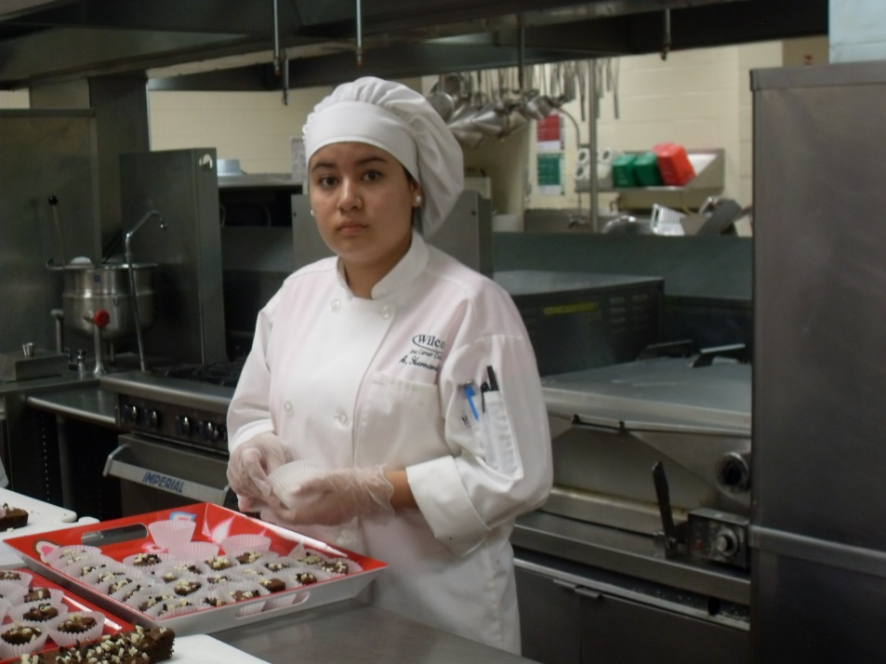
NTHS John H. Poteat Scholarship
Ana Hernandez
Wilmington High School

Slide 33
State FCCLA Finalists
NATIONAL DELEGATE: 1st Place Karybeth Archbold – Job Interviewing – Bolingbrook
Relish Tray: 1st Place – Alyssa Warren – Reed-Custer
Salad Preparation: 1st Place – Alexander Akinola – Plainfield South 1st Place – Putita Chulanon – Bolingbrook
Fondant Cake Decorating:
1st Place – Alyssa Tulian– Romeoville
1st Place – Heather Walsh– Plainfield East
Frosted Cake Decorating: 1st Place – “Most Outstanding” Lorena Fierro- Plainfield South

Slide 34
Culinary Arts Student of the Year
Hannah Eichelberger
Romeoville

Slide 35
Character Traits
Creative Thinker
Independent
Adaptable

Slide 36
Early Childhood Education
Angel Namakula-Musaazi – Plainfield South
Rebecca Nyarko – Bolingbrook

Slide 37
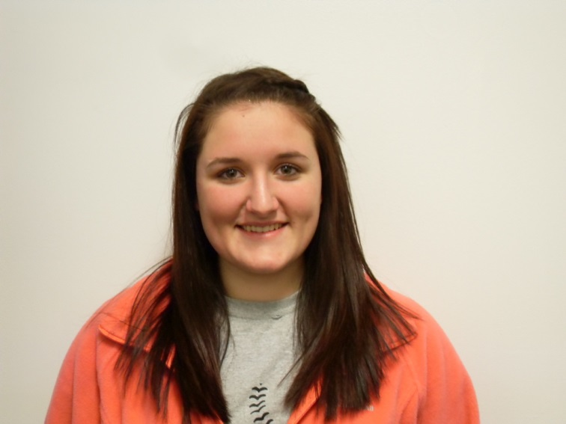
2014 Wilco Scholarship Recipients Early Childhood Education
Alicia Holligan
Wilmington

Slide 38
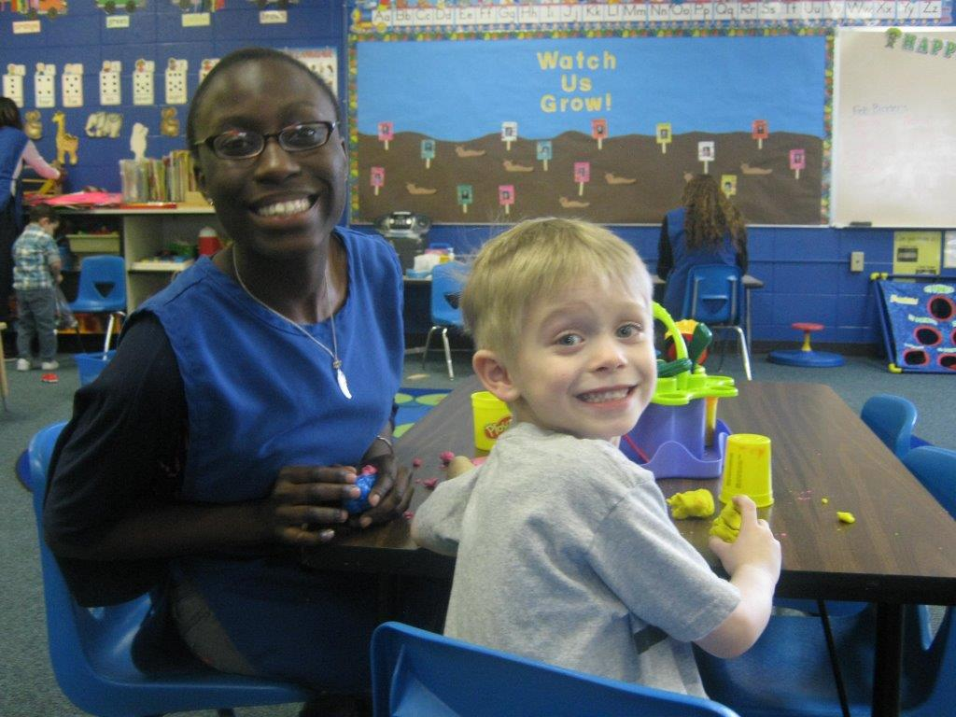
2014 Wilco Scholarship Recipients Early Childhood Education
Angel Namakula-Musaazi
Plainfield South

Slide 39
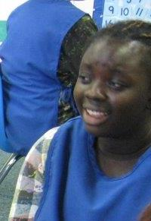
2014 Wilco Scholarship Recipient Early Childhood
Rebecca Nyarko
Bolingbrook High School

Slide 40
Golden Apple Scholarship
Jamal Bruce
Plainfield East

Slide 41
Early Childhood Education Student of the Year
Jamal Bruce
Plainfield East

Slide 42
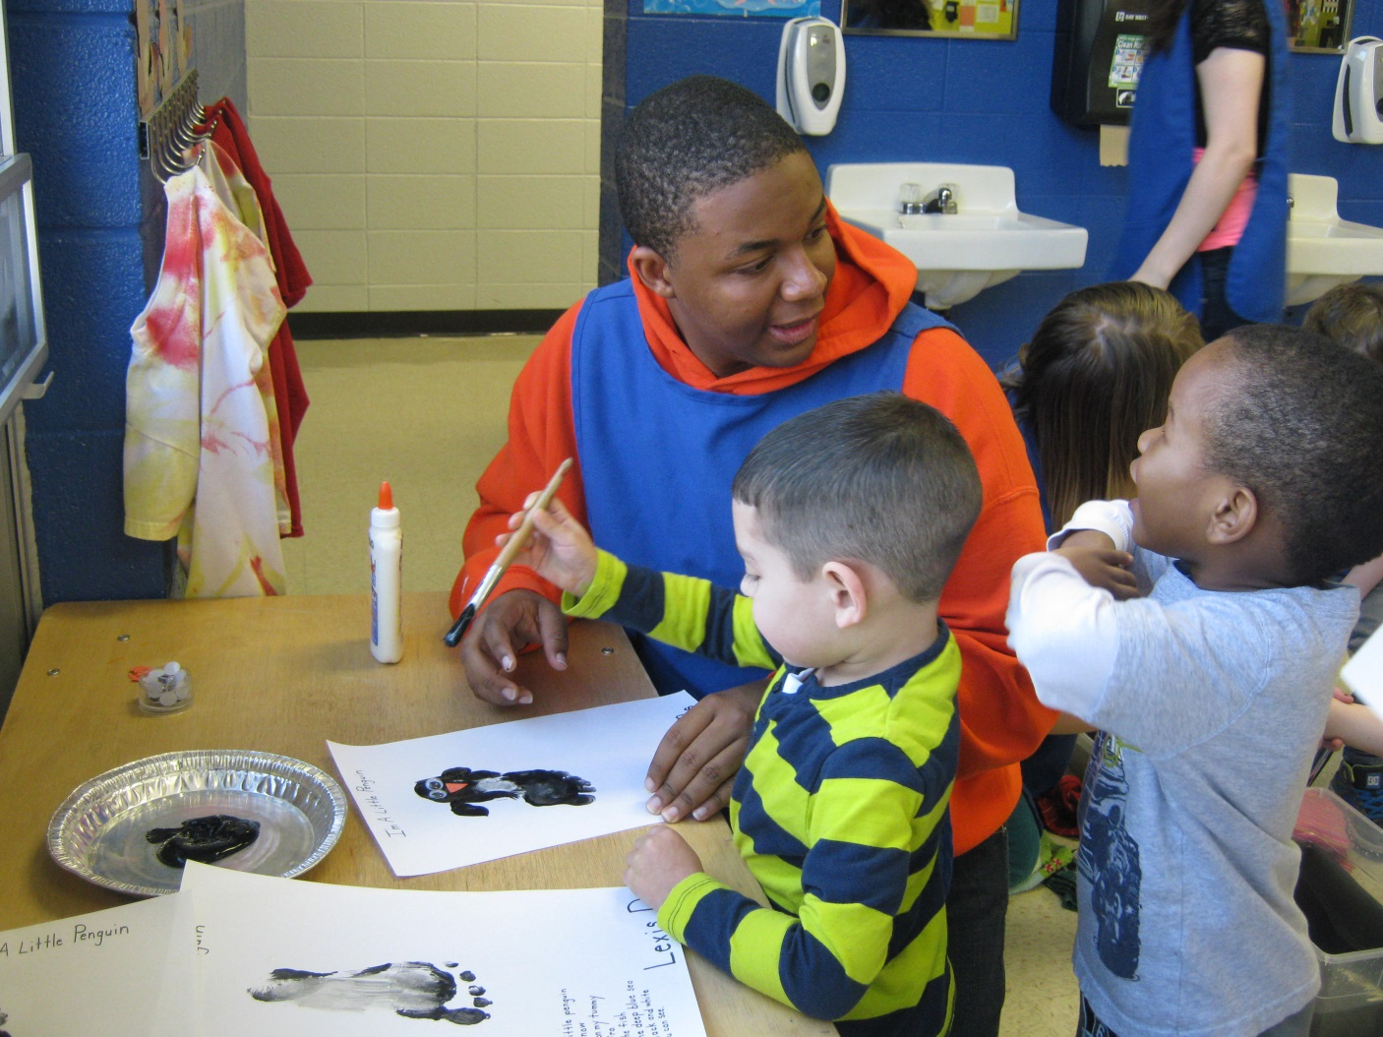
Character Traits
Responsible
Respectful
Cooperative
Manages Time
Genuine Interest
He “Gets It!”

Slide 43
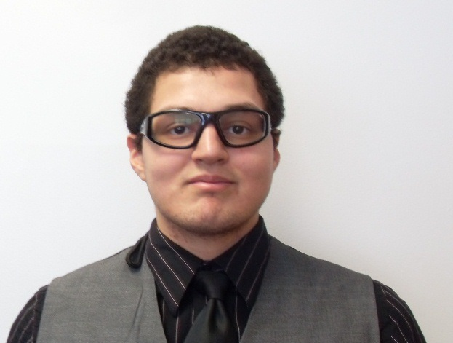
2014 Wilco Scholarship Recipient EMS Program
Armani Bonilla
Romeoville High School

Slide 44
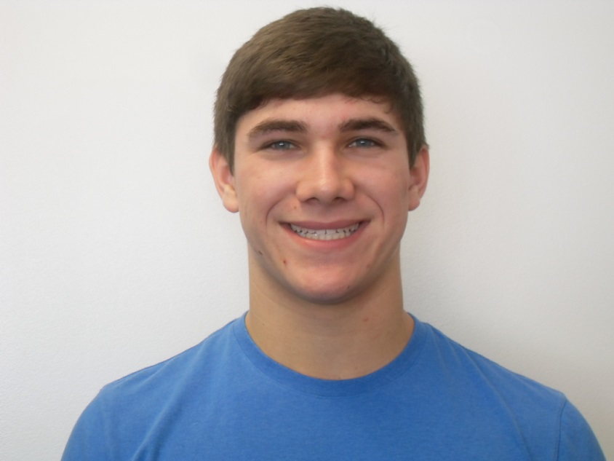
EMS Student of the Year
Lucas Mathias
Lemont

Slide 45
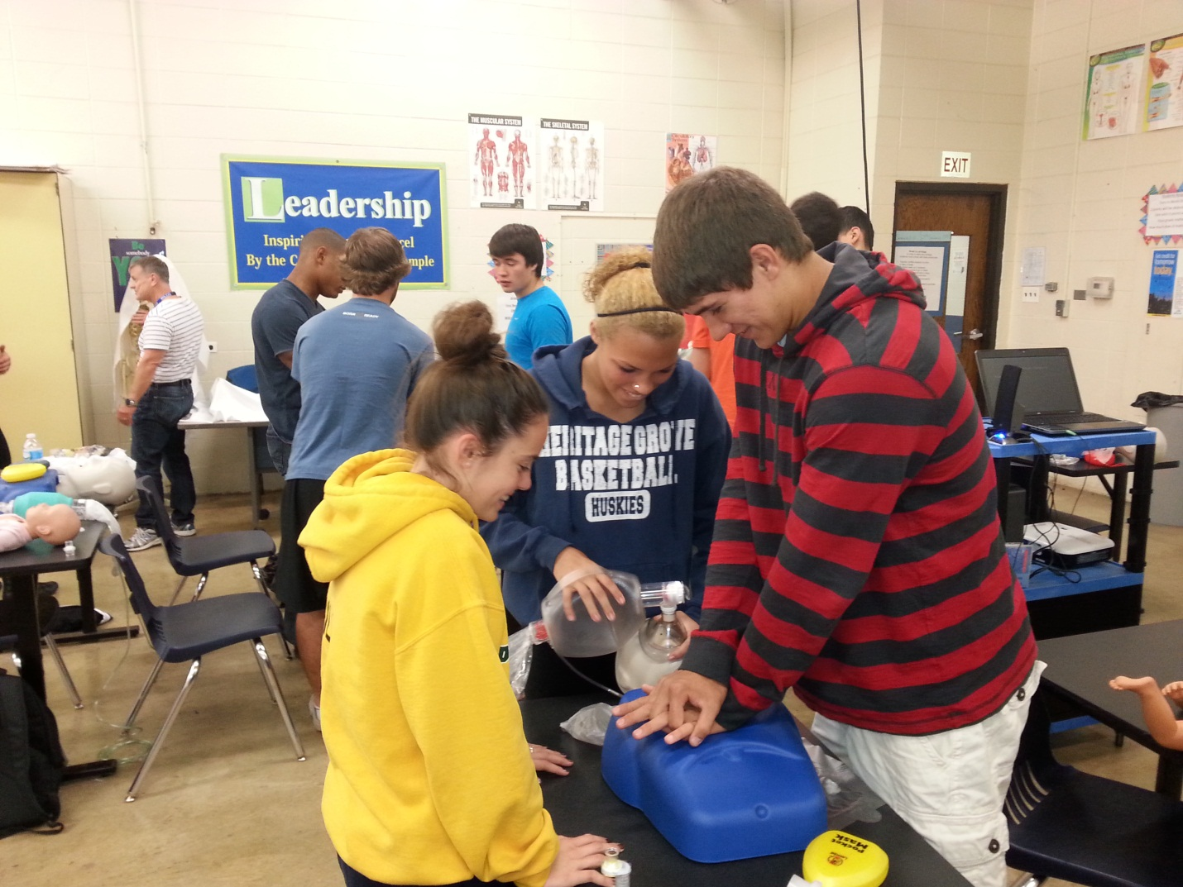
Character Traits
Hard Working
Dependable
Driven
Excellent Student
Team Player

Slide 46
Fire Science
Seth Argast– Plainfield North
Andrew Plewa – Plainfield Central
Brandon Rojas – Plainfield North
Daniel Villalejo – Plainfield South

Slide 47
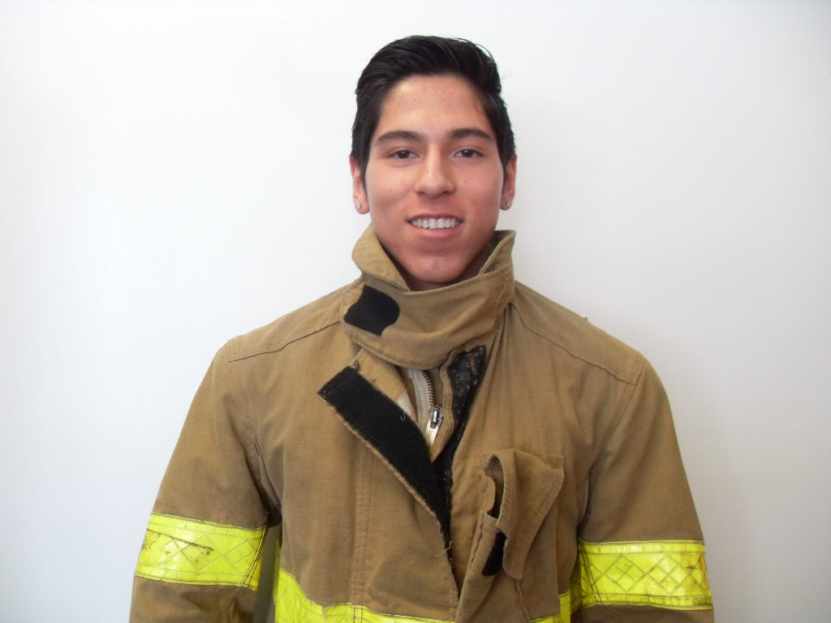
Fire Science Student of the Year
Jesse Mendoza
Romeoville

Slide 48
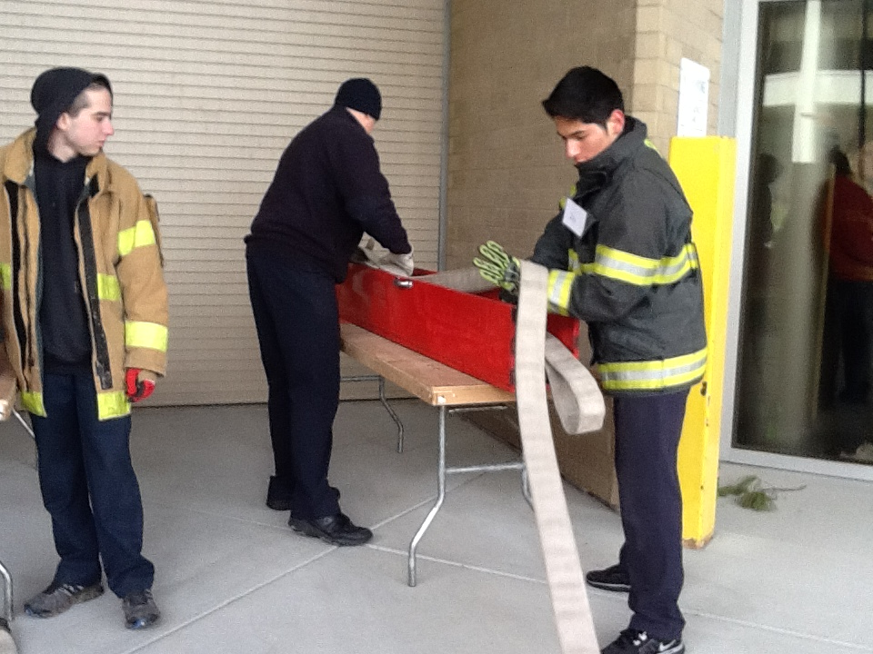
Character Traits
Self-starter
Company Officer
Always up First
Eager to Learn
Good Attitude

Slide 49
Heavy Equipment Student of the Year Bryce Antos
Reed-Custer

Slide 50
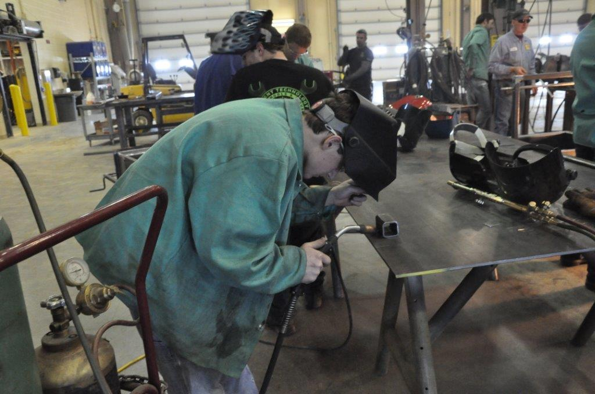
Character Traits
Dedicated
Respectful
Good Role Model
Hard Worker

Slide 51
Intro to Health Professions
Yesenia Alvarado– Romeoville
Marianna Bochnak – Romeoville
Michelle Soto – Romeoville
Sydney Brandlin - Romeoville

Slide 52
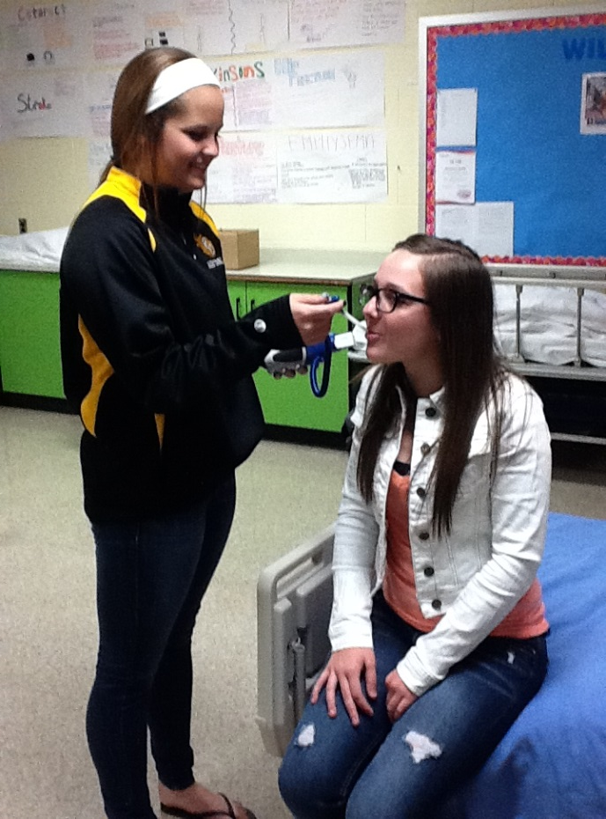
Intro to Health Professions - Braidwood Student of the Year – Mrs. Ardolino Mikayla Murphy
Reed-Custer

Slide 53
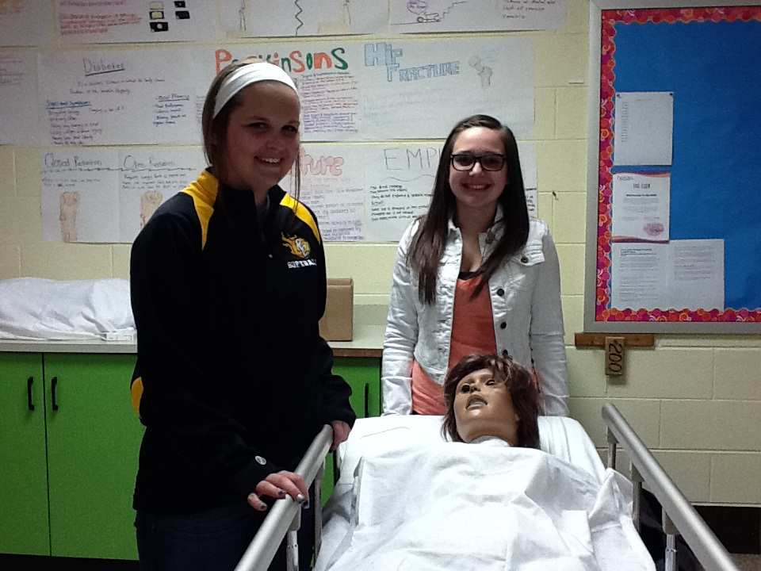
Character Traits
Cooperative
Consistent
Sense of Humor
Dependable
Responsible
Kind

Slide 54
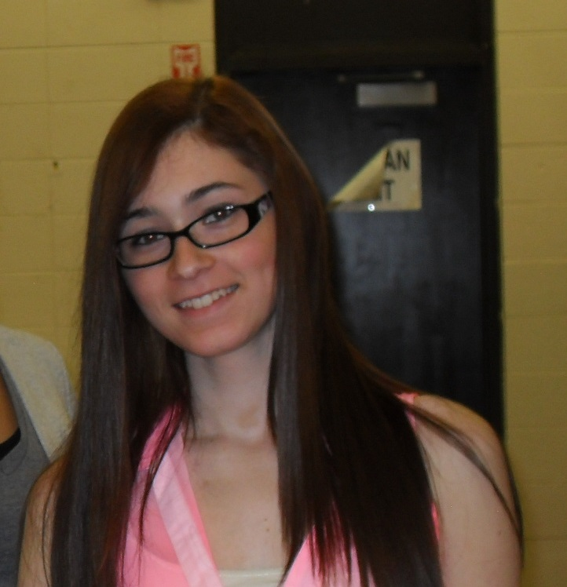
Intro to Health Professions Student of the Year -Mrs. Sillitti
Breanna Vaira
Romeoville

Slide 55
Character Traits
Maintained 98% the entire year
Helps others
Responsible
Kind
Career Oriented

Slide 56
Medical Office
Desirae Randolph – Reed-Custer

Slide 57
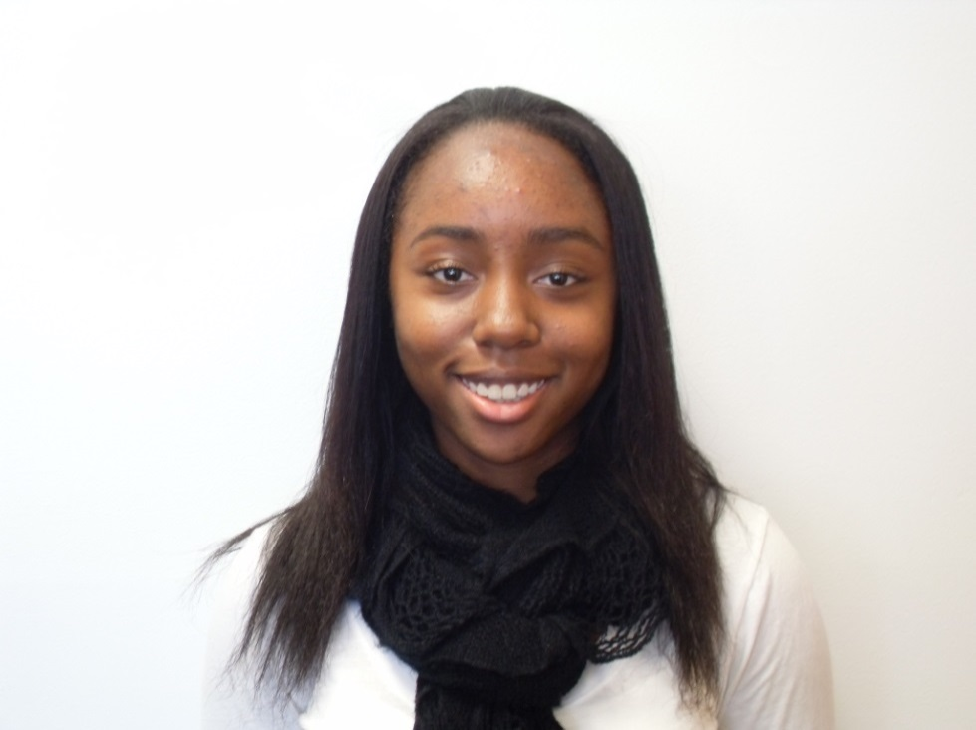
Medical Office Student of the Year
Jaalyn Robbins
Bolingbrook

Slide 58
Character Traits
Certified CNA
Patient
Compassionate
Trustworthy

Slide 59
Welding
Aurimas Sadauskas – Lemont
Thomas Sahs – Lemont

Slide 60
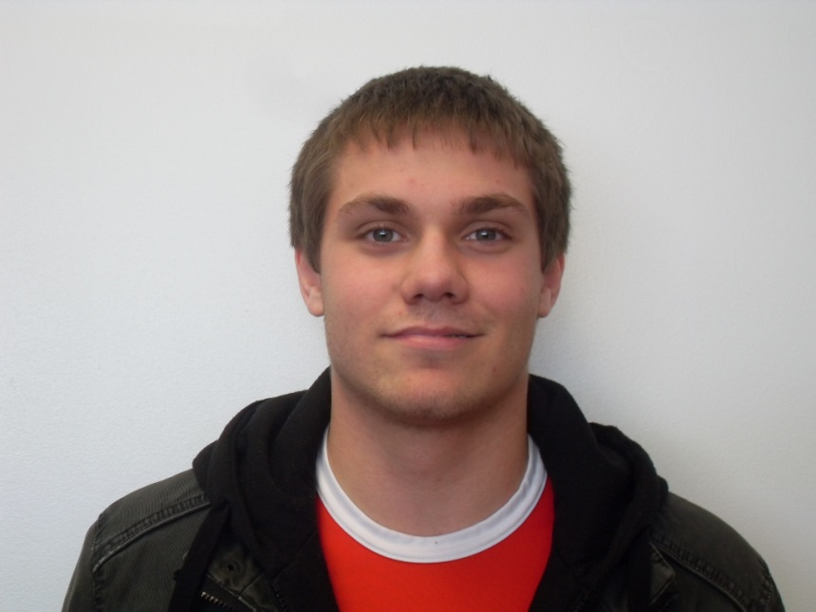
2014 Wilco Scholarship Recipient Welding Program
Ken Lebeda
Reed-Custer High School

Slide 61
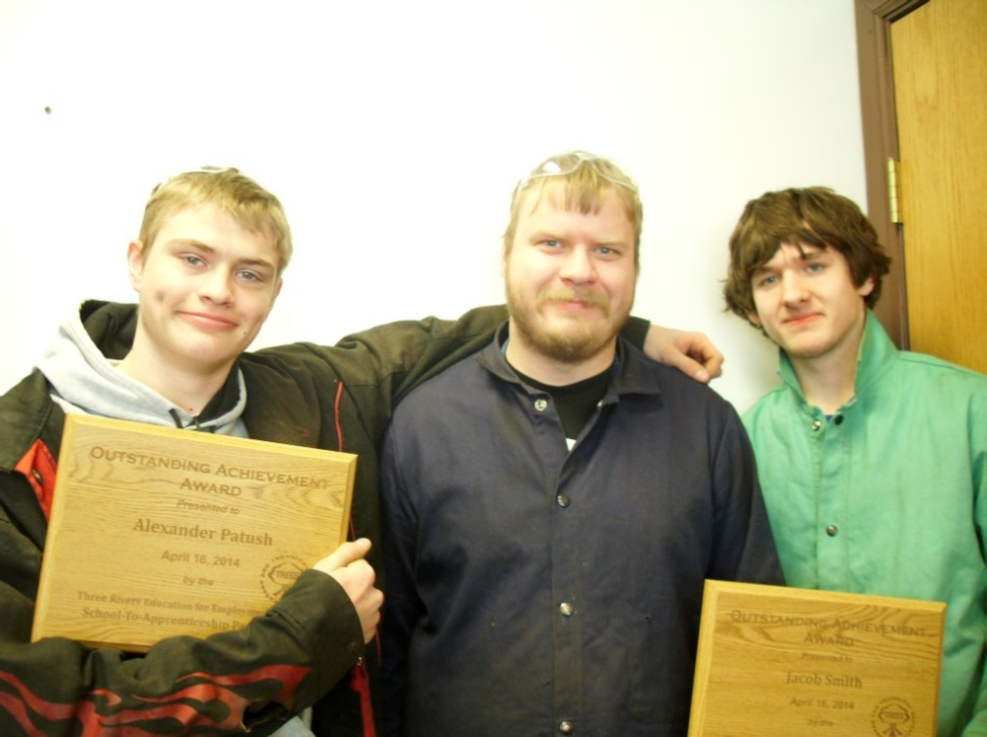
School to Apprenticeship Award Winners
Alex Patush – Plainfield Central Jacob Smith – Plainfield South

Slide 62
Welding Student of the Year
Aurimas Sadauskas
Lemont

Slide 63
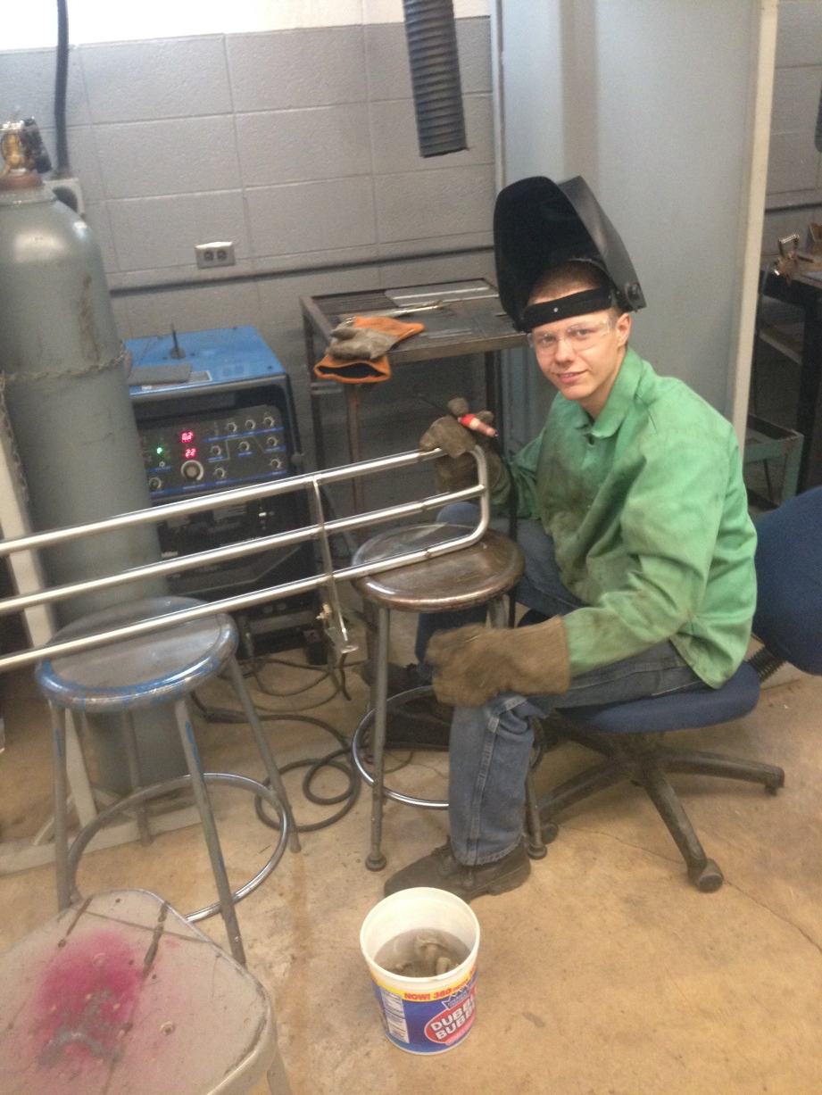
Character Traits
Welds are on par with college students
Enrolled in night classes at JJC
Hard Worker
Dedicated

Slide 64
Thank you for attending this year’s
Awards Night.
We know you are as proud of your
student as we are!
Please join us in the main office for
refreshments prepared by our Culinary
Arts students.

Slide 65
If you would like to see a copy
of the full Awards Program including all award recipients’ names, please go to the Wilco
website: www.wilco.k12.il.us

