Slide 2
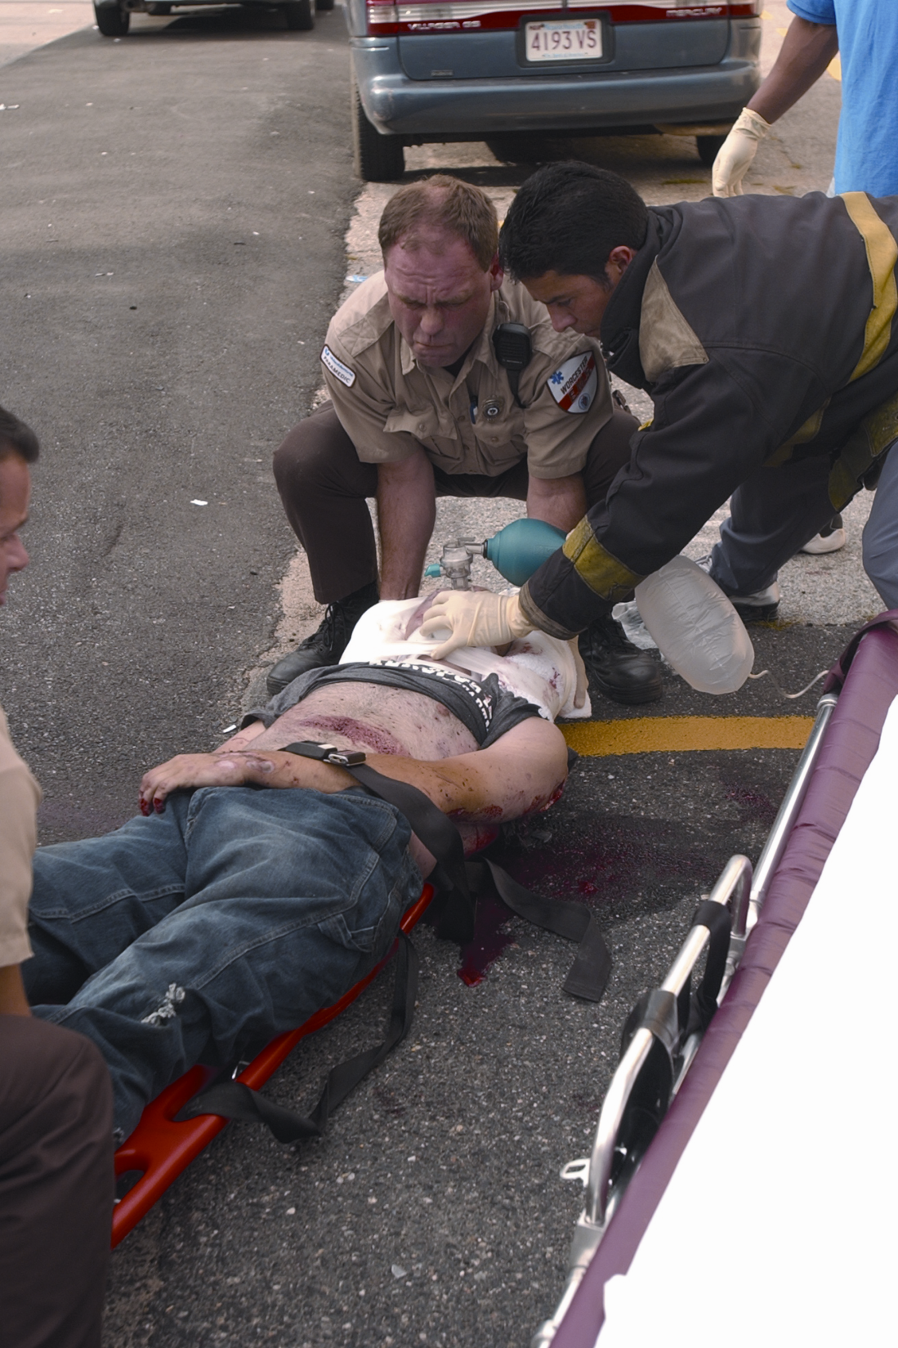
Chapter 24
Soft-Tissue Injuries

Slide 3
Introduction (1 of 3)
Soft-tissue injuries are common.
  Simple as a cut or scrape
  Serious as a life-threatening internal injury
Do not be distracted by dramatic open wounds.
  Do not forget airway obstructions.

Slide 4
Introduction (2 of 3)
Soft tissues of the body can be injured through a variety of mechanisms:
  Blunt injury
  Penetrating injury
  Barotrauma
  Burns

Slide 5
Introduction (3 of 3)
Soft-tissue trauma is the leading form of injury.
Death is often related to hemorrhage or infection.
EMTs can teach children and others preventive actions.

Slide 6
The Anatomy and Physiology of the Skin (1 of 8)
Skin is first line of defense against:
  External forces
  Infections
Skin is relatively tough, but still susceptible to injury.
  Simple bruises and abrasions to serious lacerations and amputations

Slide 7
The Anatomy and Physiology of the Skin (2 of 8)
In all instances you must:
  Control bleeding.
  Prevent further contamination to decrease the risk of infection.
  Protect wounds from further damage.
  Apply dressings and bandages to various parts of the body.

Slide 8
The Anatomy and Physiology of the Skin (3 of 8)
Skin varies in thickness.
  Thinner in the very young and very old
  Thinner on the eyelids, lips, and ears than on the scalp, back, soles of feet
  Thin skin is more easily damaged than thick skin.

Slide 9
The Anatomy and Physiology of the Skin (4 of 8)
Skin has two principal layers: the epidermis and the dermis.
  Epidermis is the tough, external layer.
  Dermis is the inner layer.

Slide 10
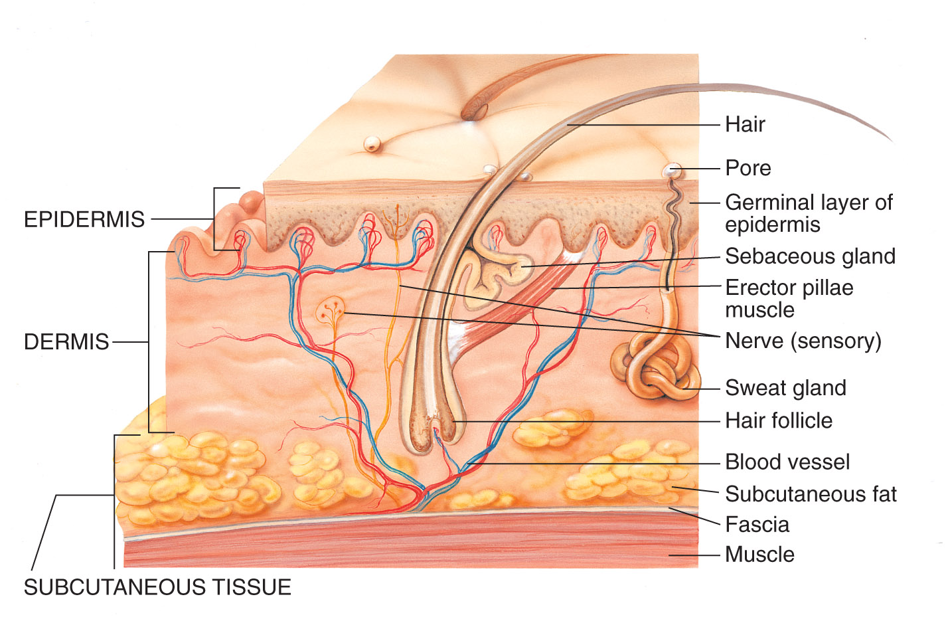
The Anatomy and Physiology of the Skin (5 of 8)

Slide 11
The Anatomy and Physiology of the Skin (6 of 8)
Skin covers all the external surfaces of the body.
Bodily openings are lined with mucous membranes.
  Mucous membranes secrete a watery substance that lubricates the openings.
  These are wet, whereas skin is dry.

Slide 12
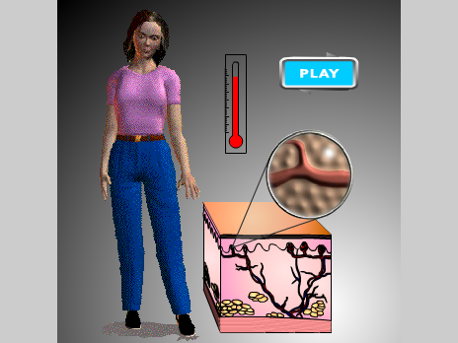
The Anatomy and Physiology of the Skin (7 of 8)
Skin serves many functions.
  Keeps pathogens out
  Keeps water in
  Assists in temperature regulation
  Nerves in skin report to brain on environment and sensations.

Slide 13
The Anatomy and Physiology of the Skin (8 of 8)
Any break in the skin allows bacteria to enter and raises the possibilities of:
  Infection
  Fluid loss
  Loss of temperature control

Slide 14
Pathophysiology (1 of 6)
Three types of soft-tissue injuries:
  Closed injuries
    Damage is beneath skin or mucous membrane.
    Surface is intact.
  Open injuries
    Break in surface of skin or mucous membrane
    Exposes deeper tissues to contamination

Slide 15
Pathophysiology (2 of 6)
Three types of soft-tissue injuries (cont’d):
  Burns
    Damage results from thermal heat, frictional heat, toxic chemicals, electricity, nuclear radiation

Slide 16
Pathophysiology (3 of 6)
Pathophysiology of closed and open injuries
  Cessation of bleeding is the primary concern.
  The next wound healing stage is inflammation.
  A new layer of cells is then moved into the damaged area.

Slide 17
Pathophysiology (4 of 6)
Pathophysiology of closed and open injuries (cont’d)
  New blood vessels form.
  Collagen provides stability to the damaged tissue and joins wound borders.

Slide 18
Pathophysiology (5 of 6)
Pathophysiology of burns
  Severity of a thermal wound correlates directly with:
    Temperature
    Concentration
    Amount of heat energy possessed by the object or substance
    Duration of exposure

Slide 19
Pathophysiology (6 of 6)
Pathophysiology of burns (cont’d)
  The greater the heat energy, the deeper the wound.
  Exposure time is an important factor.
  People reflexively limit heat energy and exposure time.
    But cannot if unconscious or trapped

Slide 20
Closed Injuries (1 of 4)
Characteristics of closed injuries
  History of blunt trauma
  Pain at the site of injury
  Swelling beneath the skin
  Discoloration

Slide 21
Closed Injuries (2 of 4)
A contusion (bruise) causes bleeding beneath the skin but does not break the skin.
  Caused by blunt forces
  Buildup of blood produces blue or black ecchymosis.
A hematoma is blood collected within damaged tissue or in a body cavity.

Slide 22
Closed Injuries (3 of 4)
A crushing injury occurs when a great amount of force is applied to the body.
Extent of damage depends on:
  Amount of force
  Length of time force is applied
When an area of the body is trapped for longer than 4 hours, crush syndrome can develop.

Slide 23
Closed Injuries (4 of 4)
Compartment syndrome results from the swelling that occurs whenever tissues are injured.
Severe closed injuries can also damage internal organs.
  Assess all patients with closed injuries for more serious hidden injuries.

Slide 24
Open Injuries (1 of 7)
Protective layer of the skin is damaged.
Wound is contaminated and may become infected.
Four types:
  Abrasions
  Lacerations
  Avulsions
  Penetrating wounds

Slide 25
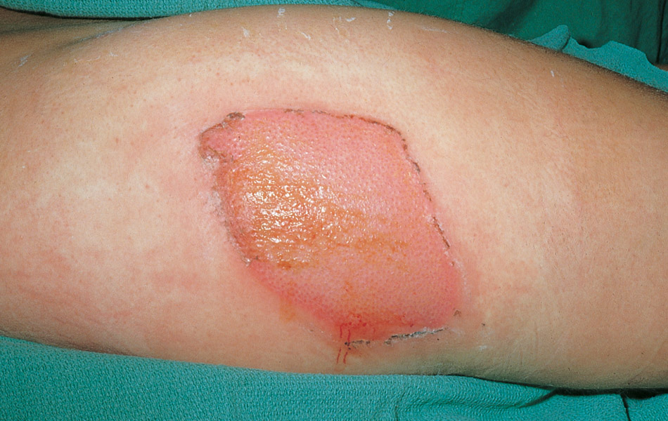
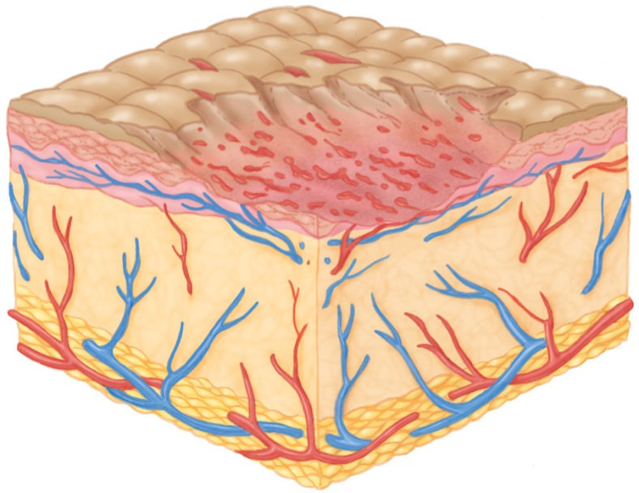
Open Injuries (2 of 7)
An abrasion is a wound of the superficial layer of the skin.
  Caused by friction when a body part rubs or scrapes across a rough or hard surface

Slide 26
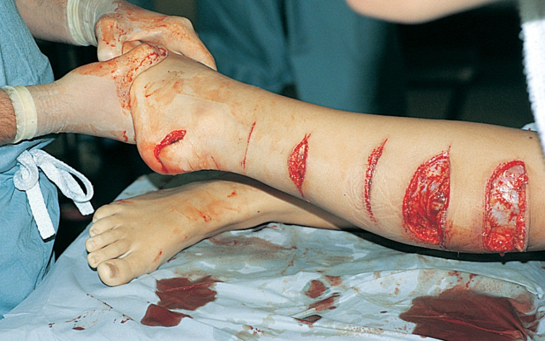
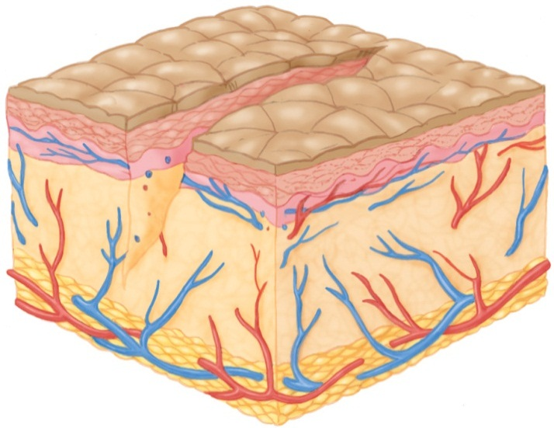
Open Injuries (3 of 7)
A laceration is a jagged cut.
  Caused by a sharp object or blunt force that tears the tissue
An incision is a sharp, smooth cut.
Source: © English/Custom Medical Stock Photography

Slide 27
Open Injuries (4 of 7)
An avulsion separates various layers of soft tissue so that they become either completely detached or hang as a flap.
  Often there is significant bleeding.
  Never remove an avulsion skin flap.
An amputation is an injury in which part of the body is completely severed.

Slide 28
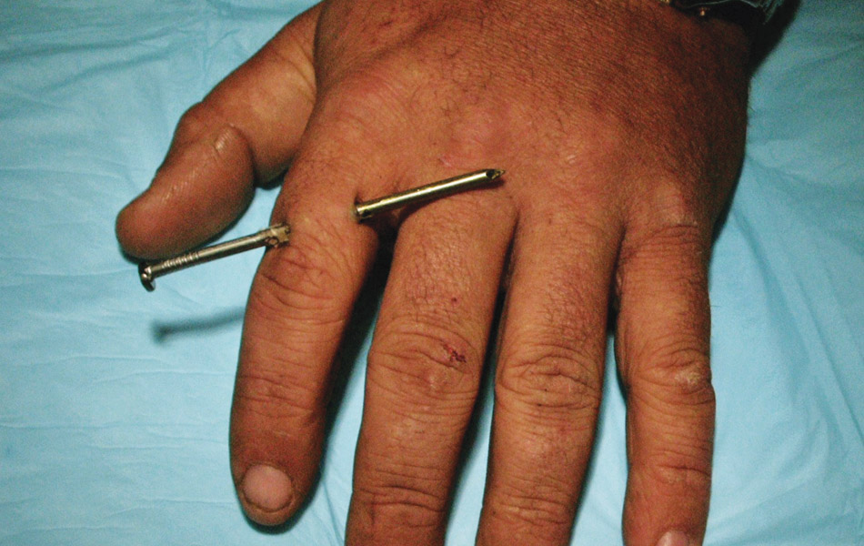
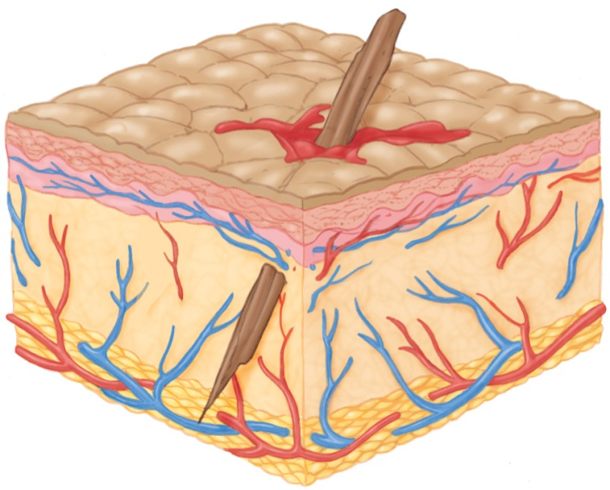
Open Injuries (5 of 7)
A penetrating wound is an injury resulting from a sharp, pointed object.
  Can damage structures deep within the body

Slide 29
Open Injuries (6 of 7)
Stabbings and shootings often result in multiple penetrating injuries.
  Assess the patient carefully to identify all wounds.
  Count the number of penetrating injuries.
  Determine the type of gun and rounds fired, and document your care.
  You may have to testify in court.

Slide 30
Open Injuries (7 of 7)
Blast injuries
  Primary blast injury
    Damage caused by pressure of explosion
  Secondary blast injury
    Damage results from flying debris
  Tertiary blast injury
    Victim is thrown by explosion, perhaps into an object

Slide 31
Patient Assessment of Closed and Open Injuries (1 of 2)
More difficult to assess a closed injury
  You can see an open injury.
Consider the possibility of a closed injury when you observe:
  Bruising
  Swelling
  Deformity
  The patient reporting pain

Slide 32
Patient Assessment of Closed and Open Injuries (2 of 2)
Patient assessment steps
  Scene size-up
  Primary assessment
  History taking
  Secondary assessment
  Reassessment

Slide 33
Scene Size-up (1 of 2)
Scene safety
  Observe the scene for hazards to yourself, your crew, and the patient.
  Assess for the potential for violence.
  Assess for environmental hazards.
  Take standard precautions.
  Determine the number of patients.
  Consider if you need additional resources.

Slide 34
Scene Size-up (2 of 2)
Mechanism of injury/nature of illness
  Look for indicators of the MOI as you assess the scene.
  The MOI may provide indicators of safety threats.
  If the scene is unsafe, request additional help early.

Slide 35
Primary Assessment (1 of 4)
Form a general impression.
  Look for indicators to alert you to the seriousness of the patient’s condition.
  Do not be distracted from looking for more serious hidden injuries.
  Check for responsiveness using the AVPU scale.

Slide 36
Primary Assessment (2 of 4)
Airway and breathing
  Ensure that the patient has a clear and patent airway.
  Protect the patient from further spinal injury.
  Assess the patient for adequate breathing.
  Inspect and palpate the chest for DCAP-BTLS.

Slide 37
Primary Assessment (3 of 4)
Circulation
  Assess the patient’s pulse rate and quality.
  Determine the skin condition, color, and temperature.
  Check the capillary refill time.
  You may need to treat for shock.
  If visible significant bleeding is seen, you must begin the steps to control it.

Slide 38
Primary Assessment (4 of 4)
Transport decision
  Immediately transport in these cases:
    Poor initial general impression
    Altered level of consciousness
    Dyspnea
    Abnormal vital signs
    Shock
    Severe pain

Slide 39
History Taking (1 of 2)
Investigate the chief complaint.
  Obtain a medical history.
  Obtain a SAMPLE history.
    Using OPQRST may provide some background on isolated extremity injuries.
  If the patient is unresponsive, attempt to obtain the history from other sources.

Slide 40
History Taking (2 of 2)
Typical signs of an open injury include:
  Bleeding
  Break(s) in the skin
  Shock
  Hemorrhage
  Disfigurement or loss of a body part

Slide 41
Secondary Assessment (1 of 4)
Physical examinations
  Is the patient in a tripod position?
  What is the skin’s color and condition?
  Are there any signs of increased respiratory efforts?
    Retractions
    Nasal flaring
    Pursed lip breathing
    Use of accessory muscles

Slide 42
Secondary Assessment (2 of 4)
Physical examinations (cont’d)
  Listen for air movement and breath sounds.
  Assess pulse rate and quality.
  Determine the skin condition, color, and temperature.
  Check the capillary refill time.

Slide 43
Secondary Assessment (3 of 4)
Physical examinations (cont’d)
  Assess the neurologic system.
  Assess the musculoskeletal system with a full-body scan.
  Assess all anatomic regions.

Slide 44
Secondary Assessment (4 of 4)
Vital signs
  You must reassess the vital signs to identify how quickly the patient’s condition is changing.
  Use appropriate monitoring devices to quantify:
    Oxygenation
    Circulatory status
    Blood pressure

Slide 45
Reassessment (1 of 3)
Repeat the primary assessment.
Reassess vital signs and the chief complaint.
Assess all bandaging frequently.
Identify and treat changes in the patient’s condition.

Slide 46
Reassessment (2 of 3)
Interventions
  Assess and manage all threats to the patient’s airway, breathing, and circulation.
  Expose all wounds, cleanse the wound surface, control bleeding, and be prepared to treat for shock.
  Extremities that are painful, swollen, or deformed should be splinted.

Slide 47
Reassessment (3 of 3)
Communication and documentation
  Description of the MOI
  Position in which you found the patient
  Amount of blood loss
  Location and description of any soft-tissue injuries or other wounds
  Size and depth of the injury
  How you treated the injuries

Slide 48
Emergency Medical Care for Closed Injuries (1 of 3)
No special emergency care for small contusions
Soft-tissue injuries may look rather dramatic.
  Still focus on airway and breathing first
  You may have to assist ventilations with a bag-mask device.

Slide 49
Emergency Medical Care for Closed Injuries (2 of 3)
Treat closed soft-tissue injury using the RICES mnemonic:
  Rest
  Ice
  Compression
  Elevation
  Splinting

Slide 50
Emergency Medical Care for Closed Injuries (3 of 3)
Signs of developing shock:
  Anxiety or agitation
  Changes in mental status
  Increased heart rate
  Increased respiratory rate
  Diaphoresis
  Cool or clammy skin
  Decreased blood pressure

Slide 51
Emergency Medical Care for Open Injuries (1 of 12)
Before caring for the patient, follow standard precautions.
Wear gloves and eye protection.
  Wear a gown and a mask if necessary.
Make sure the airway is open and administer high-flow oxygen.

Slide 52
Emergency Medical Care for Open Injuries (2 of 12)
Control life-threatening bleeding using:
  Direct, even pressure and elevation
  Pressure dressings and/or splints
  Tourniquets
Follow the steps in Skill Drill 24-1 to control bleeding from an extremity.

Slide 53
Emergency Medical Care for Open Injuries (4 of 12)
All open wounds are assumed to be contaminated and present a risk of infection.
Often, you can better control bleeding from an open soft-tissue wound by splinting the extremity, even if there is no fracture.

Slide 54
Emergency Medical Care for Open Injuries (5 of 12)
Abdominal wounds
  An open wound in the abdominal cavity may expose internal organs.
  The organs may even protrude through the wound, an injury called evisceration.

Slide 55
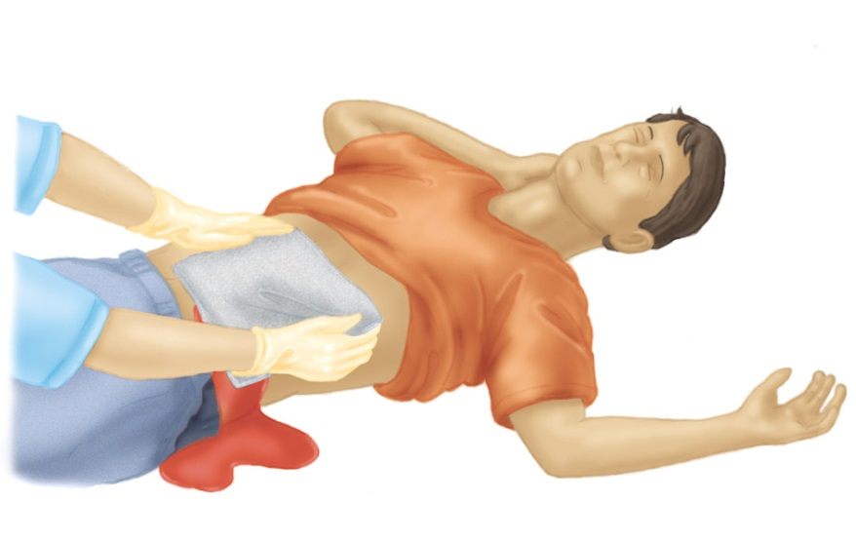
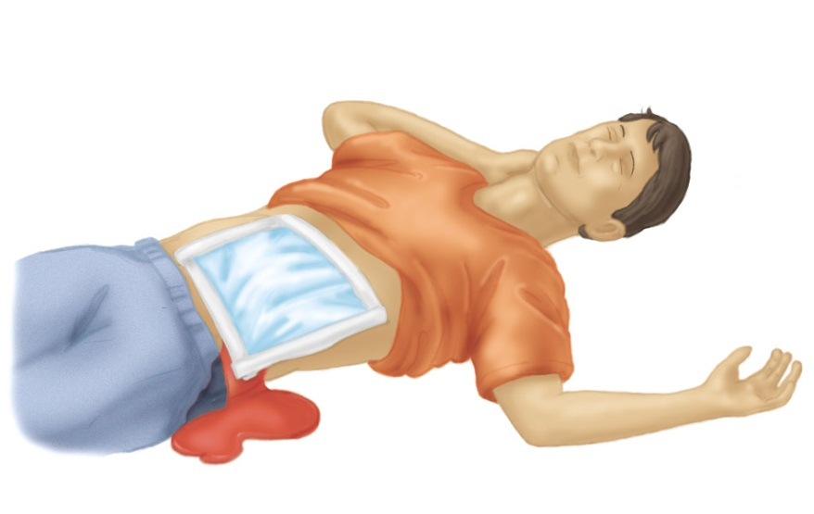
Emergency Medical Care for Open Injuries (6 of 12)
Abdominal wounds (cont’d)
  Cover the wound with sterile gauze.
  Secure with an occlusive dressing.
  Keep the organs moist and warm.

Slide 56
Emergency Medical Care for Open Injuries (7 of 12)
Impaled objects
  To treat an impaled object, follow the steps in Skill Drill 24-2.
  Only remove an impaled object when:
    The object is in the cheek and obstructs breathing.
    The object is in the chest and interferes with CPR.

Slide 57
Emergency Medical Care for Open Injuries (8 of 12)
Neck injuries
  Open neck injuries can be life threatening.
  Open veins may suck in air and cause cardiac arrest.
  Cover the wound with an occlusive dressing.
  Apply pressure but do not compress both carotid arteries at the same time.

Slide 58
Emergency Medical Care for Open Injuries (9 of 12)
Small-animal bites
  A small animal’s mouth is heavily contaminated with virulent bacteria.
  Wounds may require:
    Antibiotics
    Tetanus prophylaxis
    Suturing
  Bites should be evaluated by a physician.

Slide 59
Emergency Medical Care for Open Injuries (10 of 12)
A major concern is the spread of rabies.
  Acute, potentially fatal viral infection of the central nervous system
  Can affect all warm-blooded animals
  Transmitted through biting or licking an open wound
  Prevented by a series of special vaccine injections

Slide 60
Emergency Medical Care for Open Injuries (11 of 12)
Human bites
  The human mouth contains an exceptionally wide range of virulent bacteria and viruses.
  Regard any human bite that has penetrated the skin as a very serious injury.
  Can result in a serious, spreading infection

Slide 61
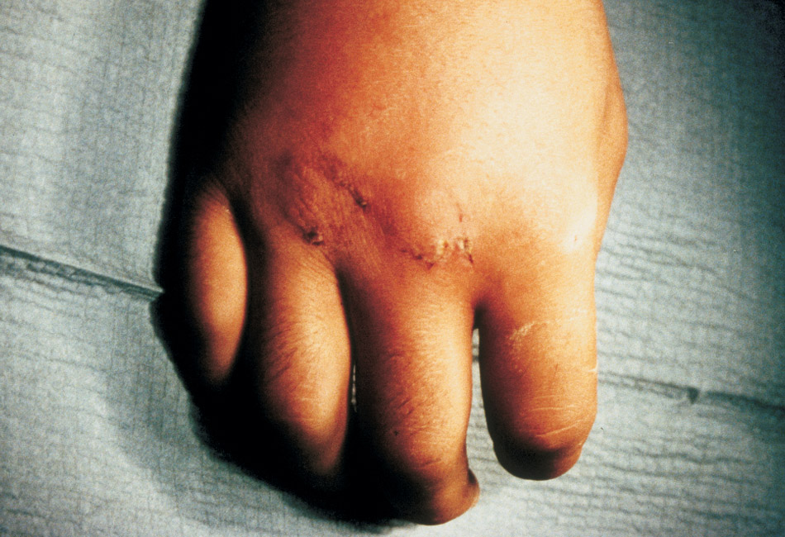
Emergency Medical Care for Open Injuries (12 of 12)
Emergency treatment:
  Apply a dry, sterile dressing.
  Promptly immobilize the area with a splint or bandage.
  Provide transport to the ED.

Slide 62
Burns (1 of 2)
Account for over 10,000 deaths a year
Among the most serious and painful of all injuries
A burn occurs when the body receives more radiant energy than it can absorb.
  Sources of this energy include heat, toxic chemicals, and electricity.

Slide 63
Burns (2 of 2)
Always perform a complete assessment to determine whether there are other serious injuries.

Slide 64
Complications of Burns (1 of 2)
When a person is burned, the skin that acts as a barrier is destroyed.
The victim is now at high risk for:
  Infection
  Hypothermia
  Hypovolemia
  Shock

Slide 65
Complications of Burns (2 of 2)
Burns to the airway are of significant importance.
Circumferential burns of the chest can compromise breathing.
Circumferential burns of the extremity can lead to neurovascular compromise and irreversible damage.

Slide 66
Burn Severity (1 of 5)
Burn severity depends on:
  Depth of burn
  Extent of burn
  Critical areas involved
    Face, upper airway, hands, feet, genitalia
  Preexisting medical conditions
  Patient younger than 5 or older than 55

Slide 67
Burn Severity (2 of 5)
Depth
  Superficial (first-degree) burns
    Only the top layer of skin
  Partial-thickness (second-degree) burns
    Epidermis and some portion of the dermis
    Blisters are present.
  Full-thickness (third-degree) burns
    Extend through all skin layers.

Slide 68
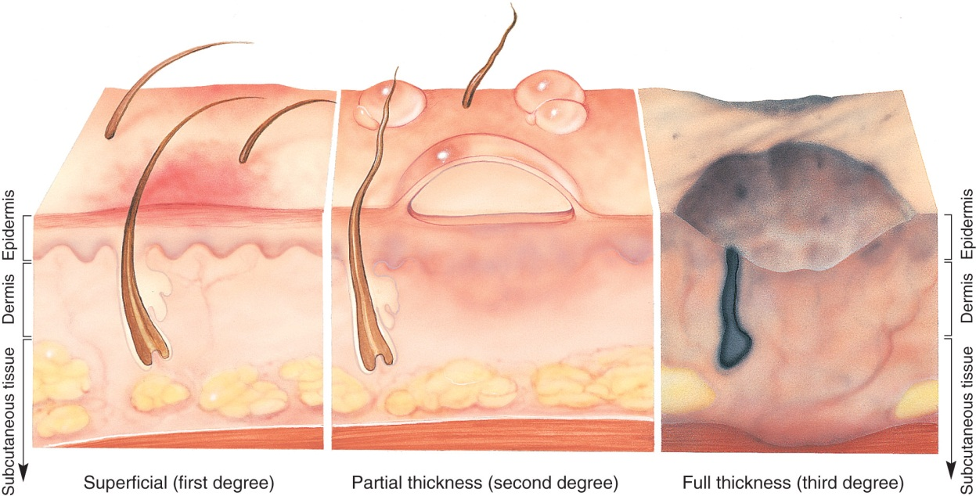
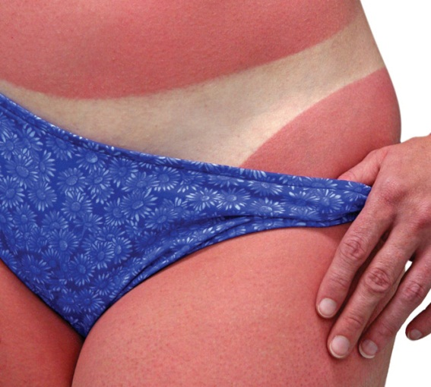
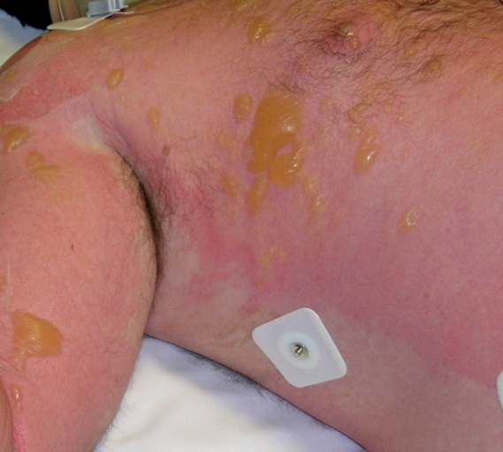
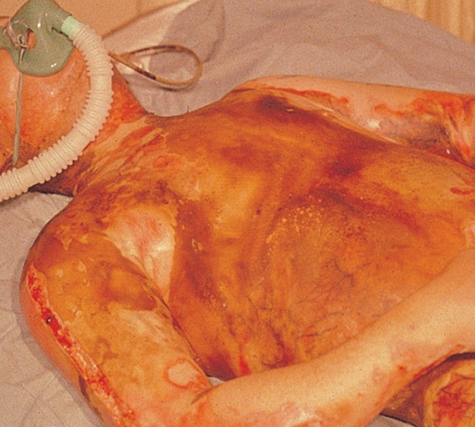
Burn Severity (3 of 5)
© Amy Walters/ShutterStock, Inc.
© E.M. Singletary, M.D. Used with permission.

Slide 69
Burn Severity (4 of 5)
Extent
  Can be estimated using the rule of nines
  Divides the body into sections, each representing approximately 9% of the total body surface area
  Proportions differ for infants, children, and adults

Slide 70
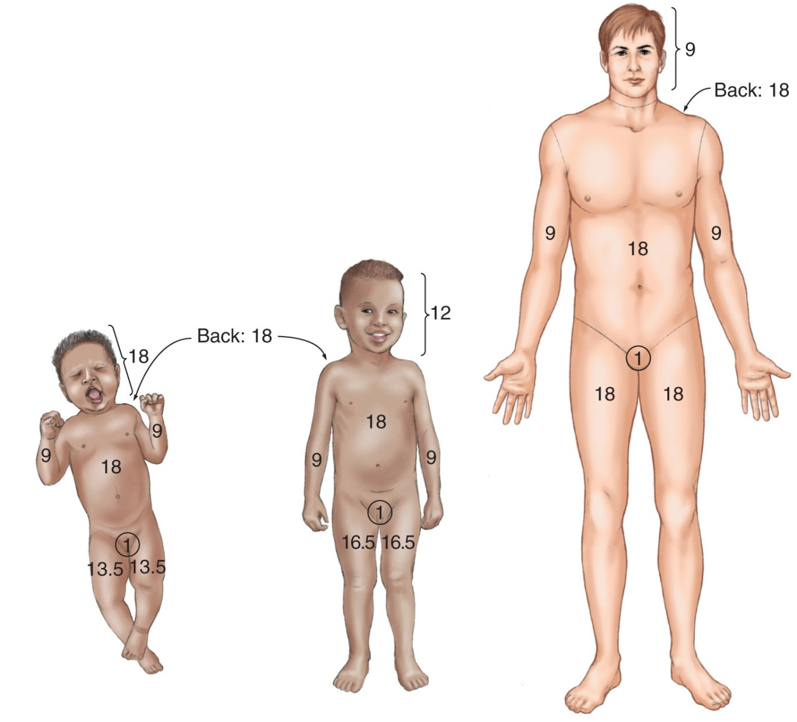
Burn Severity (5 of 5)

