Slide 2
Chemical Burns (1 of 4)
Can occur whenever a toxic substance contacts the body
Generally caused by strong acids or strong alkalis
The eyes are particularly vulnerable.

Slide 3
Chemical Burns (2 of 4)
The severity of the burn is directly related to the:
  Type of chemical
  Concentration of the chemical
  Duration of the exposure
Wear appropriate chemical-resistant gloves and eye protection.

Slide 4
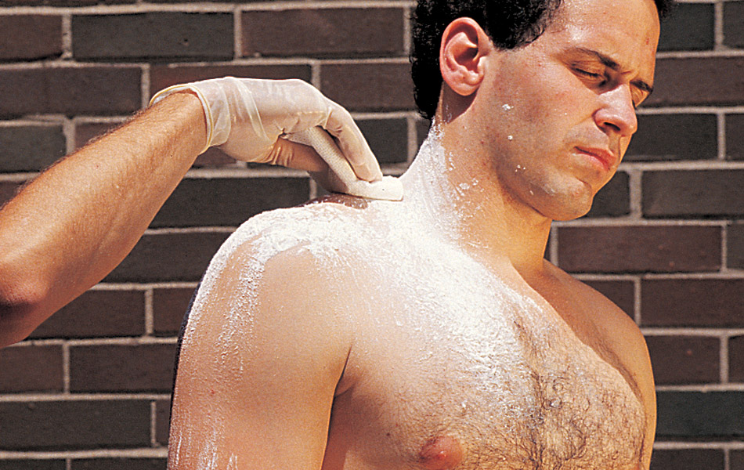
Chemical Burns (3 of 4)
Management
  Remove any chemical from the patient.
  Always brush dry chemicals off the skin and clothing before flushing with water.
  Remove the patient’s clothing.

Slide 5
Chemical Burns (4 of 4)
Management (cont’d)
  For liquid chemicals, immediately begin to flush the burned area with lots of water.
  Continue flooding the area for 15 to 20 minutes after the patient says the burning pain has stopped.
  If the patient’s eye has been burned, hold the eyelid open while flooding the eye.

Slide 6
Electrical Burns (1 of 5)
May be the result of contact with high- or low-voltage electricity
For electricity to flow, there must be a complete circuit between the source and the ground.
  Any substance that prevents this circuit is called an insulator.
  Any substance that allows a current to flow is called a conductor.

Slide 7
Electrical Burns (2 of 5)
The human body is a good conductor.
The type of electric current, magnitude of current, and voltage have effects on the seriousness of the burn.
Your safety is of particular importance.
  Never attempt to remove someone from an electrical source unless you are specially trained to do so.

Slide 8
Electrical Burns (3 of 5)
A burn injury appears where the electricity enters and exits the body.
Two dangers:
  There may be a large amount of deep tissue injury.
  The patient may go into cardiac or respiratory arrest from the electric shock.

Slide 9
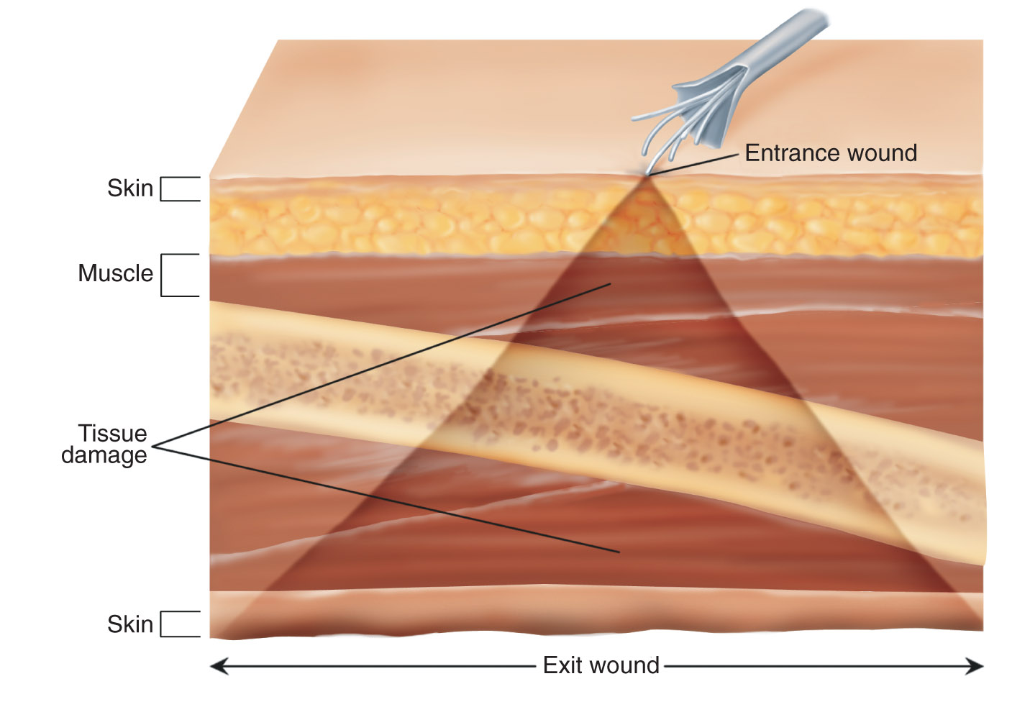
Electrical Burns (4 of 5)

Slide 10
Electrical Burns (5 of 5)
Management
  If indicated, begin CPR on the patient and apply an AED.
  Be prepared to defibrillate if necessary.
  Give supplemental oxygen and monitor.
  Treat soft-tissue injuries with dry, sterile dressings.
  Provide prompt transport.

Slide 11
Thermal Burns (1 of 3)
Caused by heat
Most commonly, they are caused by scalds or an open flame.
  A flame burn is very often a deep burn.
  Hot liquids produce scald injuries.
Coming in contact with hot objects produces a contact burn.

Slide 12
Thermal Burns (2 of 3)
A steam burn can produce a topical burn.
A flash burn is produced by an explosion.
  May briefly expose a person to very intense heat
  Lightning strikes can cause a flash burn.

Slide 13
Thermal Burns (3 of 3)
Management
  Stop the burning source, cool the burned area, and remove all jewelry.
  Increased exposure time will increase damage to the patient.
  All patients should have a dry dressing applied to:
    Maintain body temperature
    Prevent infection
    Provide comfort

Slide 14
Inhalation Burns (1 of 4)
Can occur when burning takes place in enclosed spaces without ventilation
  Upper airway damage is often associated with the inhalation of superheated gases.
  Lower airway damage is more often associated with the inhalation of chemicals and particulate matter.

Slide 15
Inhalation Burns (2 of 4)
You may encounter severe upper airway swelling, requiring intervention immediately.
  Consider requesting ALS backup.
The combustion process produces a variety of toxic gases.

Slide 16
Inhalation Burns (3 of 4)
Carbon monoxide intoxication should be considered whenever a group of people in the same place all report a headache or nausea.
Management
  First ensure your own safety and the safety of your coworkers.

Slide 17
Inhalation Burns (4 of 4)
Management (cont’d)
  Prehospital treatment for a patient with suspected hydrogen cyanide poisoning includes decontamination and supportive care.
  Care for any toxic gas exposure includes:
    Recognition
    Identification
    Supportive treatment

Slide 18
Radiation Burns (1 of 4)
Potential threats include:
  Incidents related to the use and transportation of radioactive isotopes
  Intentionally released radioactivity in terrorist attacks
You must determine if there has been a radiation exposure and then whether ongoing exposure continues to exist.

Slide 19
Radiation Burns (2 of 4)
Three types of ionizing radiation:
  Alpha
    Little penetrating energy, easily stopped by the skin
  Beta
    Greater penetrating power, but blocked by simple protective clothing
  Gamma
    Very penetrating, easily passes through the body and solid materials

Slide 20
Radiation Burns (3 of 4)
Most ionizing radiation accidents involve gamma radiation, or x-rays.
Management
  Patients with a radioactive source on their body must be initially cared for by a HazMat responder.
  Irrigate open wounds.
  Notify the emergency department.

Slide 21
Radiation Burns (4 of 4)
Management (cont’d)
  Identify the radioactive source and the length of the patient’s exposure to it.
  Limit your duration of exposure.
  Increase your distance from the source.
  Attempt to place shielding between yourself and the sources of gamma radiation.

Slide 22
Patient Assessment of Burns
(1 of 2)
When you are assessing a burn, it is important for you to classify the victim’s burns.
Classification involves determining the:
  Source of the burn
  Depth of the burn
  Severity

Slide 23
Patient Assessment of Burns
(2 of 2)
Patient assessment steps
  Scene size-up
  Primary assessment
  History taking
  Secondary assessment
  Reassessment

Slide 24
Scene Size-up
Scene safety
  Observe the scene for hazards and safety threats.
  Ensure that the factors that led to the patient’s burn injury do not pose a hazard.
Mechanism of injury/nature of illness
  Determine the type of burn that has been sustained and the MOI.

Slide 25
Primary Assessment (1 of 5)
Begin with a rapid scan.
Form a general impression.
  Be suspicious of clues that may indicate abuse.
  Consider the need for manual spinal stabilization.
  Check for responsiveness using the AVPU scale.

Slide 26
Primary Assessment (2 of 5)
Airway and breathing
  Ensure that the patient has a clear and patent airway.
  Be alert to signs that the patient has inhaled hot gases or vapors:
    Singed facial hair
    Soot present in and around the airway

Slide 27
Primary Assessment (3 of 5)
Airway and breathing (cont’d)
  Copious secretions and frequent coughing may indicate a respiratory burn.
  Quickly assess for adequate breathing.
  Inspect and palpate the chest wall for
  DCAP-BTLS.

Slide 28
Primary Assessment (4 of 5)
Circulation
  Assess the pulse rate and quality.
  Determine perfusion based on the patient’s skin condition, color, temperature, and capillary refill time.
  Control significant bleeding.
  Assess for shock.

Slide 29
Primary Assessment (5 of 5)
Transport decision
  Consider quickly transporting a patient who has:
    An airway or breathing problem
    Significant burn injuries
    Significant external bleeding
    Signs and symptoms of internal bleeding
  Consider a rendezvous with ALS providers.

Slide 30
History Taking (1 of 3)
Investigate the chief complaint.
  Be alert for signs and symptoms of other injuries due to the MOI.
  Typical signs of a burn are:
    Pain
    Redness
    Swelling
    Blisters
    Charring

Slide 31
History Taking (2 of 3)
Investigate the chief complaint (cont’d).
  Regardless of the type of burn injury, it is important for you to:
    Stop the burning process.
    Apply dressings to prevent contamination.
    Treat the patient for shock.

Slide 32
History Taking (3 of 3)
SAMPLE history
  Along with the SAMPLE history, also ask the following questions:
    Are you having any difficulty breathing?
    Are you having any difficulty swallowing?
    Are you having any pain?
  Check whether the patient has an emergency medical identification device.

Slide 33
Secondary Assessment (1 of 2)
Physical examinations
  Perform a full-body scan.
  Make a rough estimate, using the rule of nines, of the extent of the burned area.
  Determine the classification of the burn.
  Determine the severity of the burn.
  Package the patient for transport.

Slide 34
Secondary Assessment (2 of 2)
Physical examinations (cont’d)
  Assessment of the respiratory system involves looking, listening, and feeling.
  Assess the patient’s neurologic system.
  Assess the musculoskeletal system.
  Determining an early set of vital signs will help you to know how your patient is tolerating his or her injuries.

Slide 35
Reassessment (1 of 3)
Repeat the primary assessment and reassess the patient’s vital signs.
Reassess the chief complaint.
Reevaluate interventions
  Stop the burning process.
  Assess and treat breathing.
  Support circulation.

Slide 36
Reassessment (2 of 3)
Reassess interventions (cont’d)
  Provide rapid transport.
  Oxygen is mandatory for inhalation burns but is also helpful in patients with smaller burns.
  If the patient has signs of hypoperfusion, treat aggressively for shock and provide rapid transport.

Slide 37
Reassessment (3 of 3)
Communication and documentation
  Provide hospital personnel with a description of how the burn occurred.
  Include the extent of the burns.
    Amount of body surface area involved
    Depth of the burn
    Location of the burn
  Document if special areas are involved.

Slide 38
Emergency Medical Care for Burns
Stop the burning process.
Prevent additional injury.
Follow the steps in Skill Drill 24-3.

Slide 39
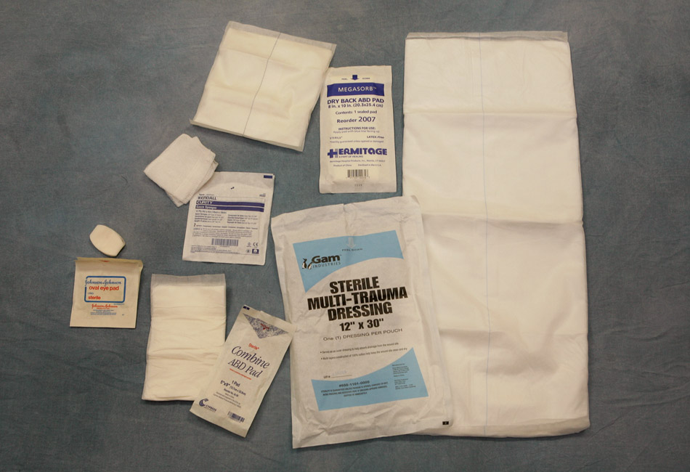
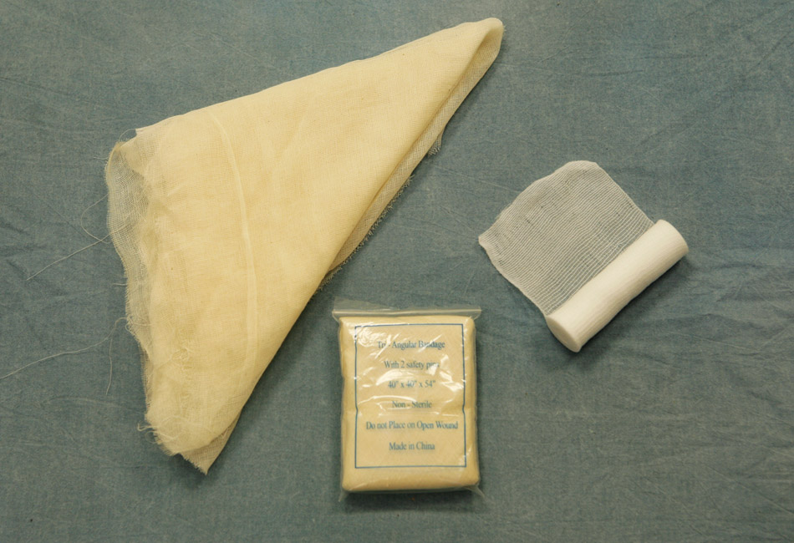
Dressing and Bandaging (1 of 2)
All wounds require bandaging.
  Sometimes splints can help control bleeding and provide firm support for dressing.
  There are many different types of dressings and bandages.
  © Jones and Bartlett Publishers. Courtesy of MIEMSS.
  © Jones and Bartlett Publishers. Courtesy of MIEMSS.

Slide 40
Dressing and Bandaging (2 of 2)
Dressings and bandages have three functions:
  To control bleeding
  To protect the wound from further damage
  To prevent further contamination and infection

Slide 41
Sterile Dressings (1 of 2)
Most wounds will be covered by:
  Universal dressings
  Conventional 4″ × 4″ and 4″ × 8″ gauze pads
  Assorted small adhesive-type dressings and soft self-adherent roller dressings
Universal dressings are ideal for covering large open wounds.

Slide 42
Sterile Dressings (2 of 2)
Gauze pads are appropriate for smaller wounds.
Adhesive-type dressings are useful for minor wounds.
Occlusive dressings prevent air and liquids from entering (or exiting) the wound.

Slide 43
Bandages (1 of 3)
To keep dressings in place during transport, you can use:
  Soft roller bandages
  Rolls of gauze
  Triangular bandages
  Adhesive tape
The self-adherent, soft roller bandages are easiest to use.

Slide 44
Bandages (2 of 3)
Adhesive tape holds small dressings in place and helps to secure larger dressings.
Do not use elastic bandages to secure dressings.
  The bandage may become a tourniquet and cause further damage.

Slide 45
Bandages (3 of 3)
Splints are useful in stabilizing broken extremities.
  Can be used with dressings to help control bleeding from soft-tissue injuries
If a wound continues to bleed despite the use of direct pressure, quickly proceed to the use of a tourniquet.

