Slide 1
20-21 Re-Opening Plan
Wilco Area Career Center

Slide 2
Our Mission
To Provide a safe environment for students and Staff in order to develop skill sets that provide a pathway to college and career readiness.

Slide 3
Guidance
This plan was developed with information from the Centers for Disease Control and prevention (CDC), the Illinois department of public health (IDPH), and the Illinois state board of education (ISBE).
Scheduling options have tentatively been discussed with districts.
The plan is intended for guidance in the development of additional protocals and procedures for individual programs and spaces at the center.

Slide 4


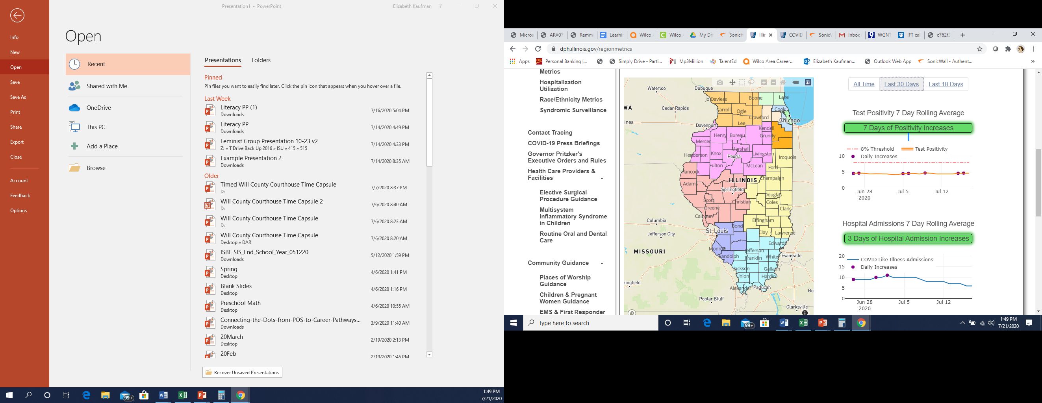
Data Notes from our Region
Rate of infection has remained stable, but cases have seen an increase
Hospitalizations have been going down.
Med Surg and ICU bed availability is still within acceptable range
https://www.dph.illinois.gov/regionmetrics

Slide 5
Over View of Safety Measures
Classes at Half Capacity for room with Six Foot Spacing
Facemasks and Face Shields
Health Safety Checks As students enter the Building to Start the Year
Handwashing or Sanitizing stations in each room
Additional Cleaning Each Day
Directional Hallways: Arrows and Circles reminding of distancing
Isolation Room
Incorporation of Outdoor Space
Additional Barriers in Bathrooms
Signs for Each Classroom with Hygiene Reminders

Slide 6
Blended Learning
Each student will be issued a @wilcoacc.org Google Account to engage in Blended Learning.
Students will focus on the theory concepts in our programs on days they are not in session at the Center through Google Classroom.
On Days in attendance at the Center, instructors will focus on the skill components of our classes.
Grading will occur as indicated in program syllabi.
Office hours will be provided between 2:30 and 3:00 Pm each day to answer additional questions students may have.
Tutoring/support services will be provided both in person and via hangouts/zoom

Slide 7
Google Classroom
169 Training Hours provided by Don Malec and Jennifer Alessi
17 Page training agenda with hyperlinks Developed
Purchase of Pear Deck as an implementation resource
Purchase of Additional Technology to assist with recording demonstrations and/or Lectures
290 Hours of Paid Curriculum Developed along with countless additional hours
Bosa and Julia working on Level I certification

Slide 8
Limitations and Cancellations
Per Guidance from IDPH and ISBE:
Only virtual field trips
Guest speakers through Zoom or Google Hangouts
Virtual Open House
Cancellation of Fall Buffets
Cancellation of Fall student tours visiting wilco
Professional development opportunities virtually or small group locally

Slide 9
Implementation of ISBE and IDPH Guidelines
Symptoms Requiring Absence
When to Return to Work
Referral to Testing for Staff with Symptoms
Communication with Feeder Schools and Will County Health Department on Contact Tracing

Slide 10
Sanitation
Added Sanitation stations to all rooms that do not have a sink
Purchase of spray bottles and towels for student to sanitize their personal space
Purchase of Machines that will Sanitize rooms each day
Increased frequency of Bathroom cleanings
Decrease the recirculated air in the building/Increase Fresh Air
Turn off water fountains

Slide 11
Scheduling
Coordinate with Union on remote learning teaching assignments to serve districts/Students who choose remote learning or to meet Medical needs
Open to students attending on off days or if on remote, as long as capacity has not been reached in the classroom
Work with Districts to balance classes at wilco
Shorten Wilco sessions to meet an Early release Schedule
All staff will report to wilco regardless of assignment unless medical documentation is provided Preventing or the state reimplements the stay at home order

Slide 12
Preschool
At this time, wilco does intend to offer our preschool program to the community. We will be utilizing the guidelines mentioned at the beginning of the presentation. ISBE is to release additional guidance for preschool programs this week.

Slide 13
Questions/Concerns
Will times be designated during the school day for students to complete their remote activities during their normally scheduled Wilco Time?
Will students be permitted to drive to wilco to join in lab activities if Districts are engaged in Remote Learning?
Will home schooled students be able to access programing as they have in the past?
How will districts utilize their ‘Remote Planning Days?’
How will Health Screening/Contact Tracing information be shared with Wilco?

Slide 14
Board Thoughts and Discussion
Thank You!

